Slide 1


Indian Institute of Information Technology, Nagpur
Department of Electronics and Communication Engineering
Final Year Project Presentation
Absorber
Presented By:
BT20ECE016 Om Gupta
BT20ECE027 Amit Yadav
BT20ECE075 Guna Sai Kiran
Supervisor :
Dr. Paritosh D. Peshwe

Slide 2
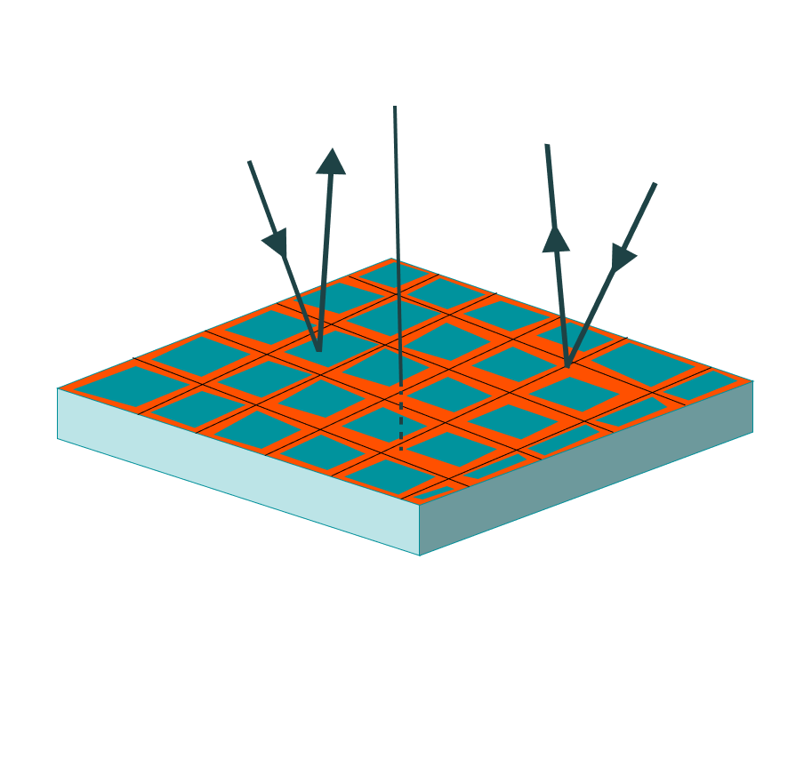
About Absorber
INCIDENT
Applications:
Telecommunications : reduce signal distortion caused by
reflections, echoes, and interference.
Aerospace: reducing the radar cross-section (RCS).
Defence: prevent the interception of sensitive electronic signals.
Objective :
Develop an efficient electromagnetic wave absorber with enhanced
performance characteristics.
Optimize absorption properties across a broad frequency range.
Achieve cost-effective and scalable fabrication methods for widespread implementation.
3D printing over PCB design.
Ease of Fabrication, Rapid prototyping, lower costs, reduces manufacturing time.
REFLECTED
Conventional PCB etching cannot selectively reduce the dielectric substrate, therefore 3-D printing is an effective solution to resolve this problem . Through selective control in the printing process, the overall weight of the dielectric cannot only be lessened, but the structure can also be made mechanically stable by choosing suitable substrate patterns. Besides, the 3-D printing technique is more efficient (compared to the PCB etching) in terms of fabrication cost, manufacturing time, and chemical waste.

Slide 3
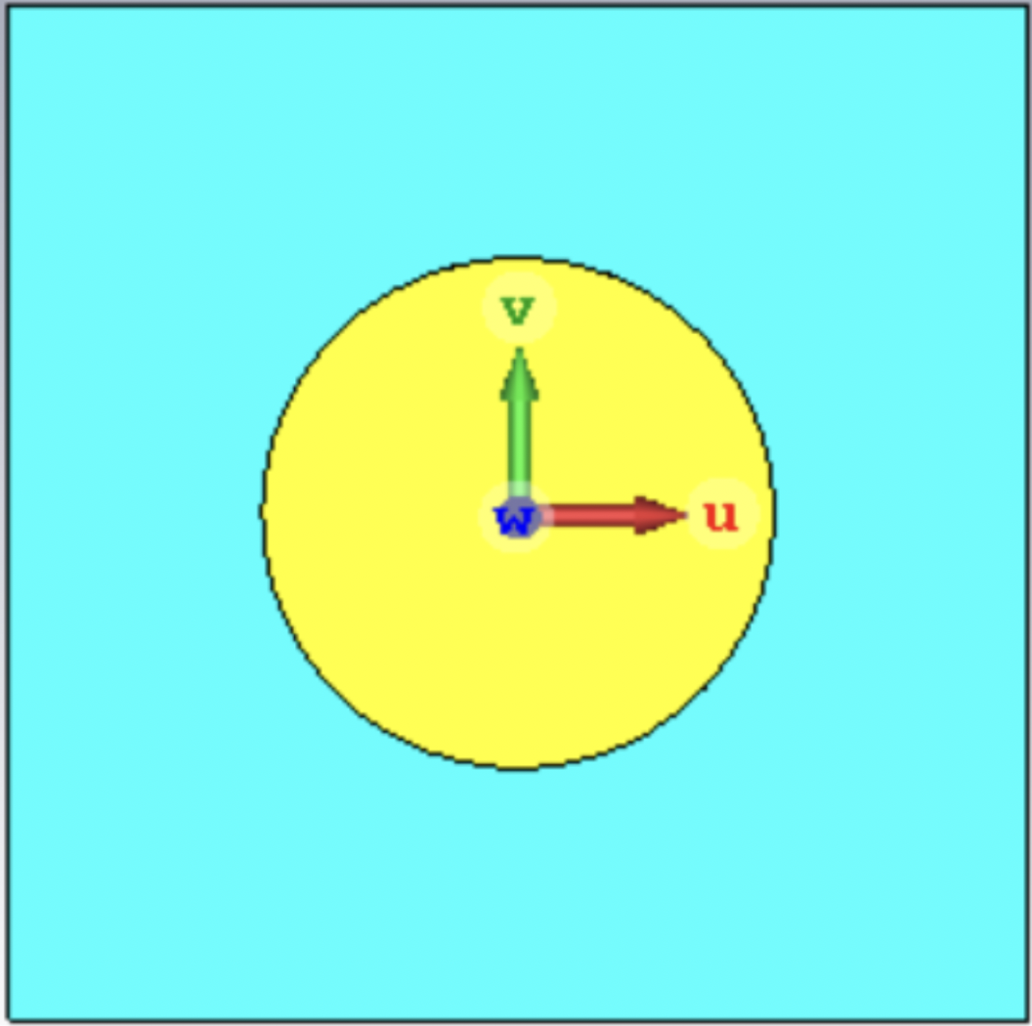

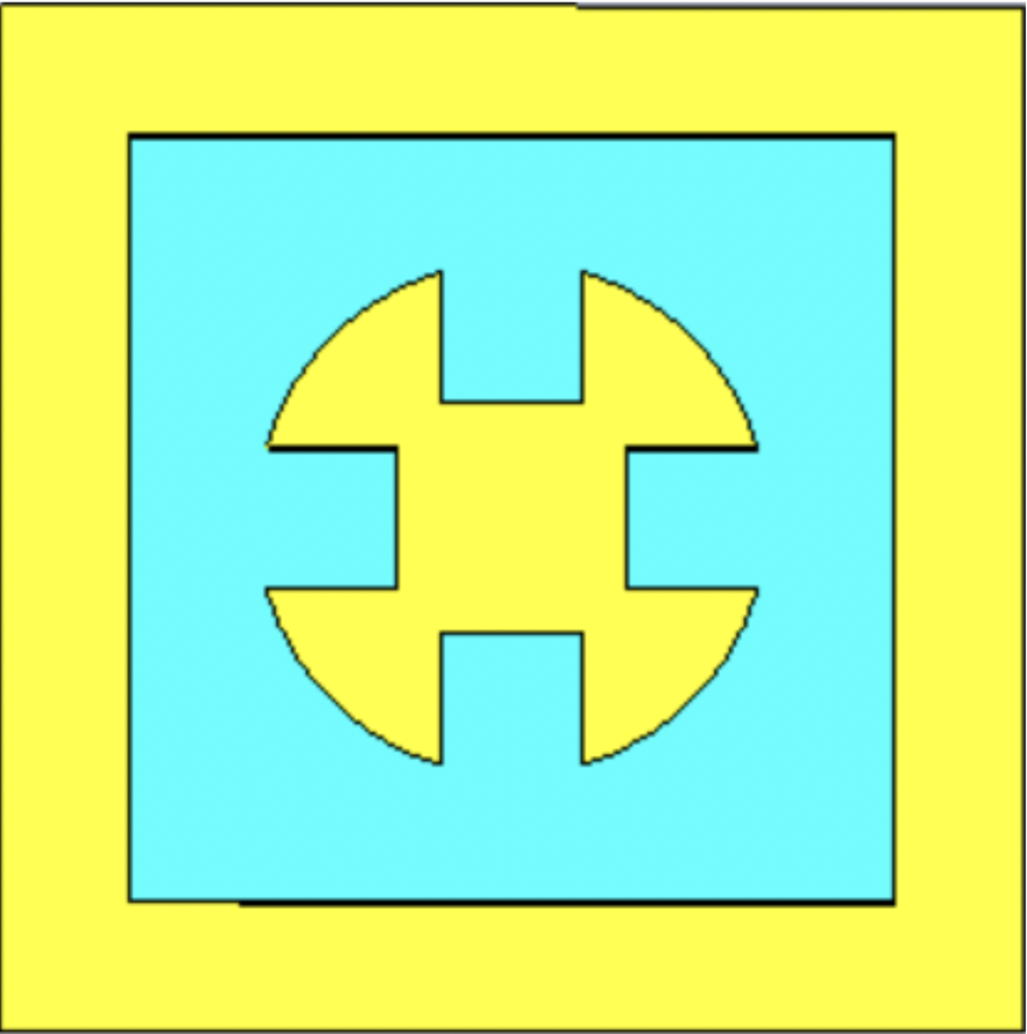

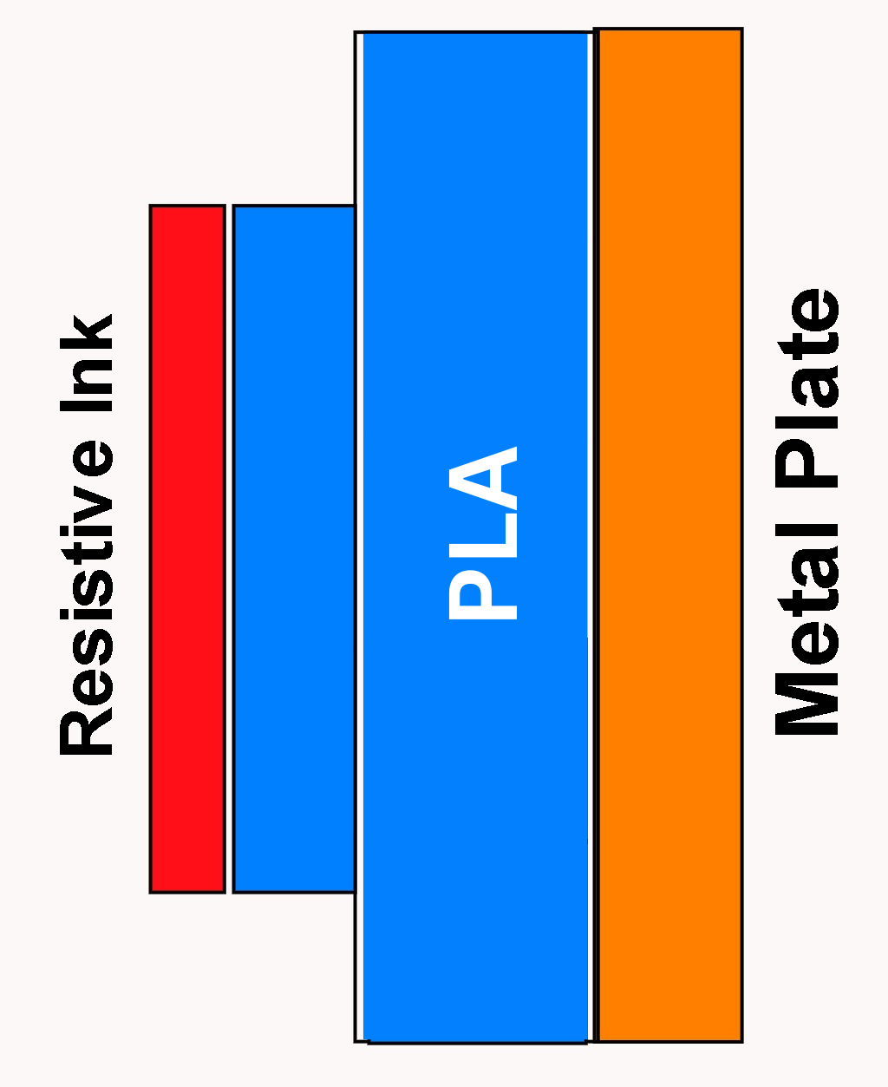
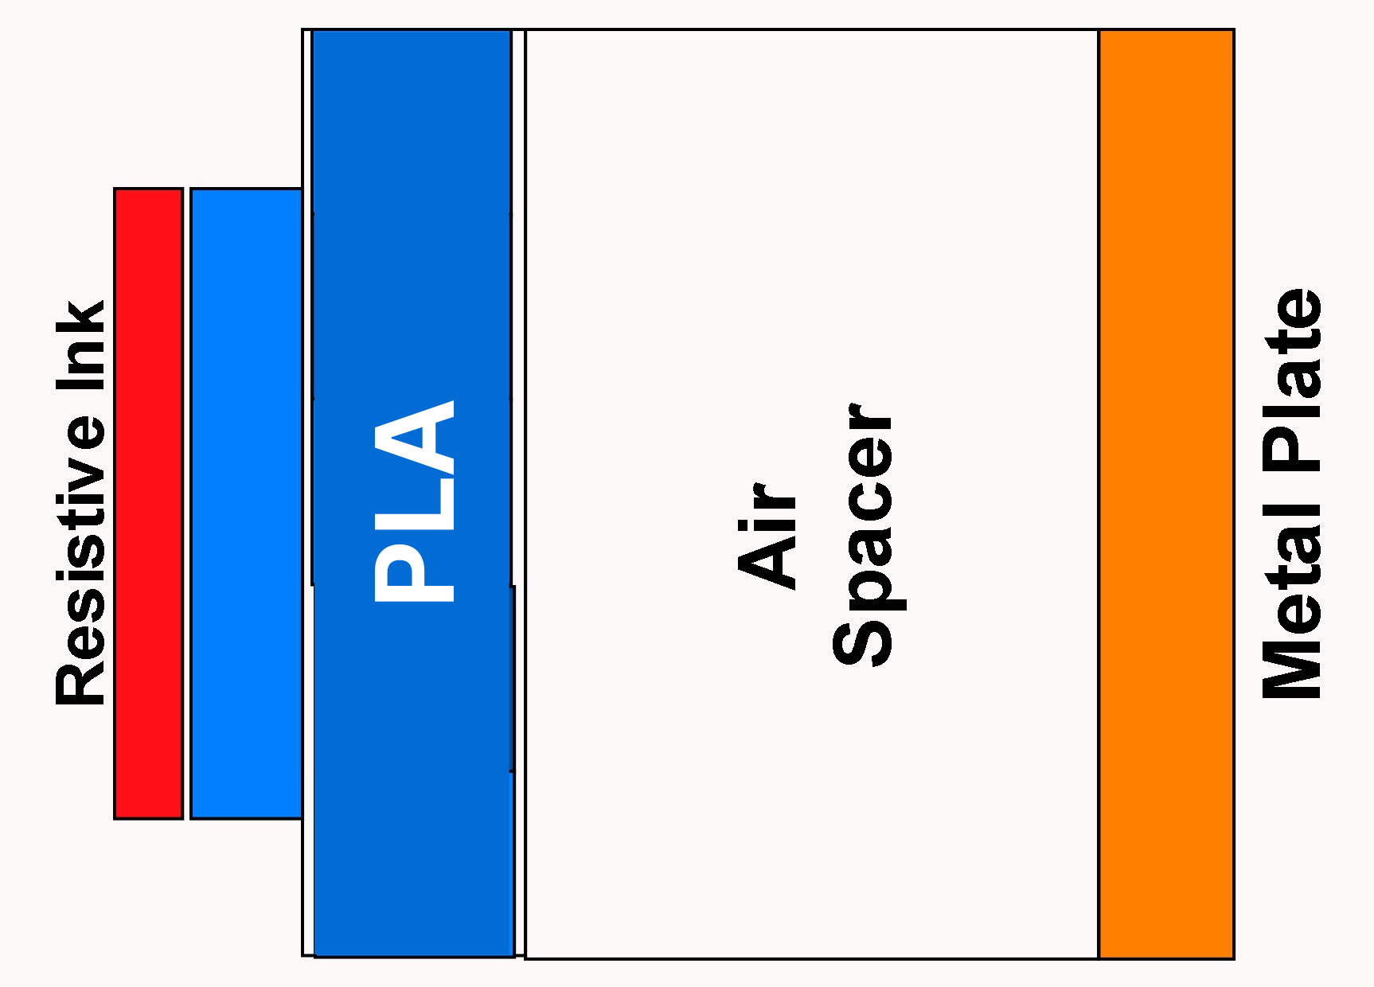
Design 1
a
b
4x2
R_out
iteration 0
(b) iteration 1
(c) iteration 2
(d) iteration 3
Dimensions (in mm)
R_out | 4 | width of substrate | 16
Square slot (a) | 2.2 | thickness of substrate | 2 (0.5 + 1.5)
width of outer patch (b) | 2 | Air gap | 1.5
size of circular slots | 0.9 | thickness of Gnd plane | 0.035
size of mid-rectangular slot | 4x2 | thickness of resistive ink | 0.02

Slide 4
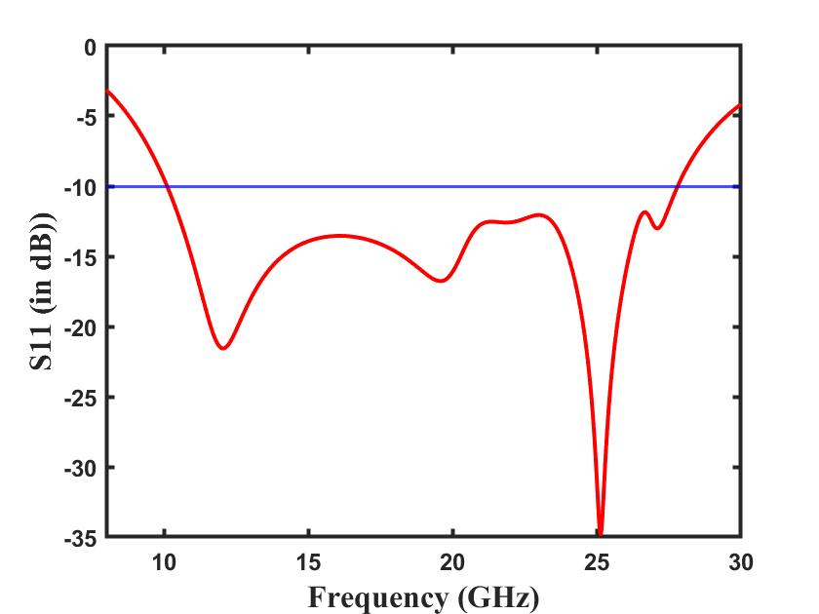

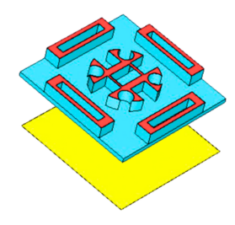
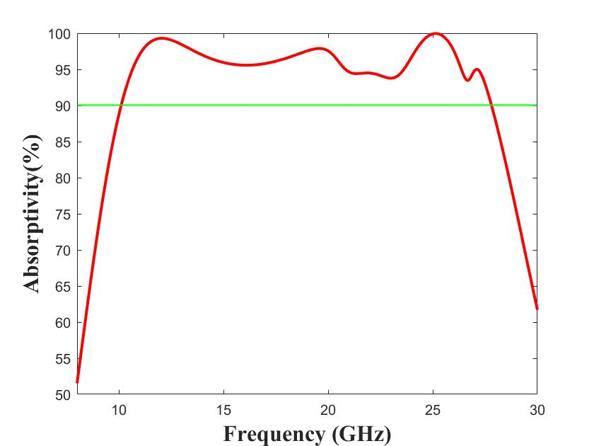

Final Design
Front View
Fig. Reflection Coefficient (S11)
Side View
Rear View
Fig.Absorption

Slide 5
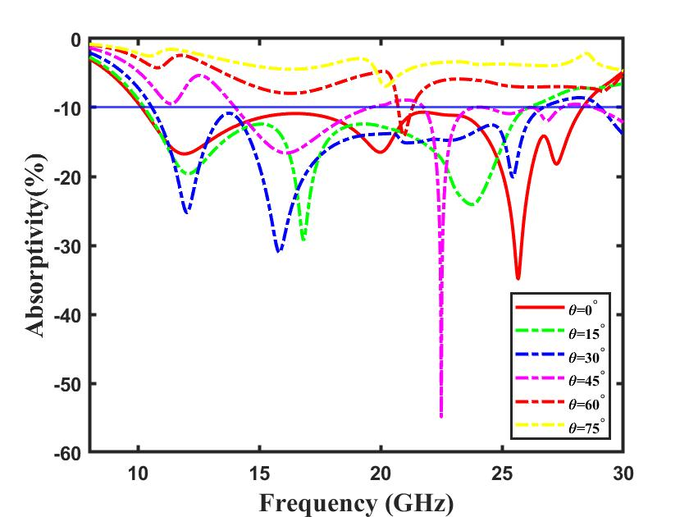
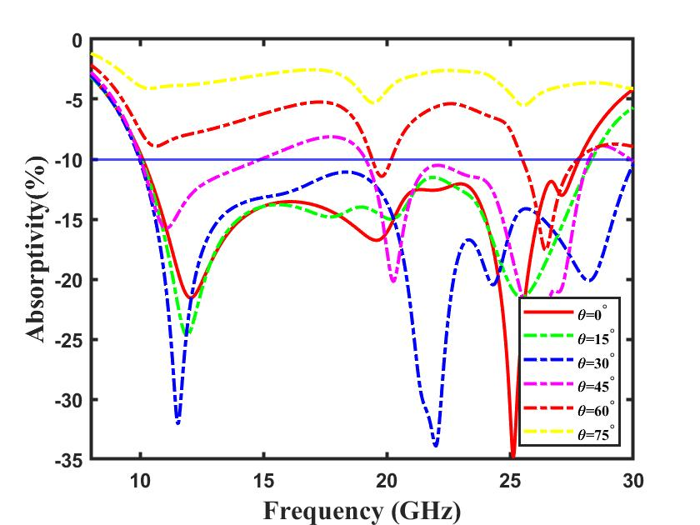
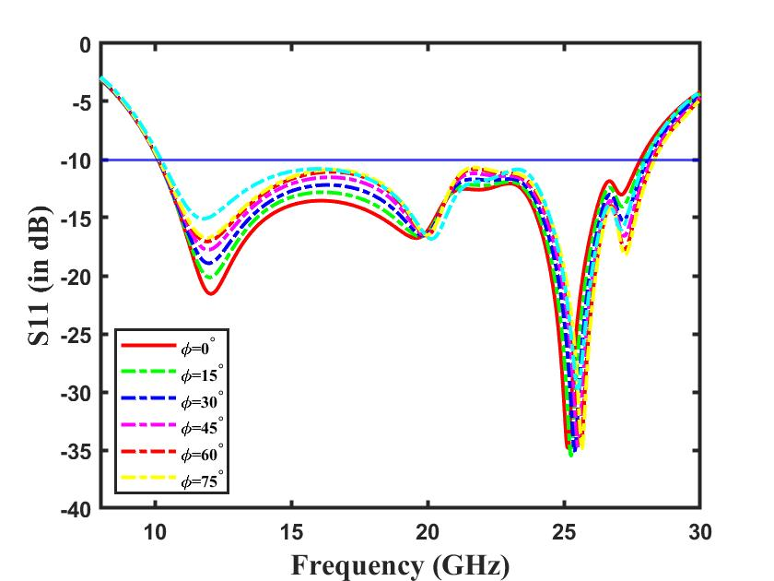
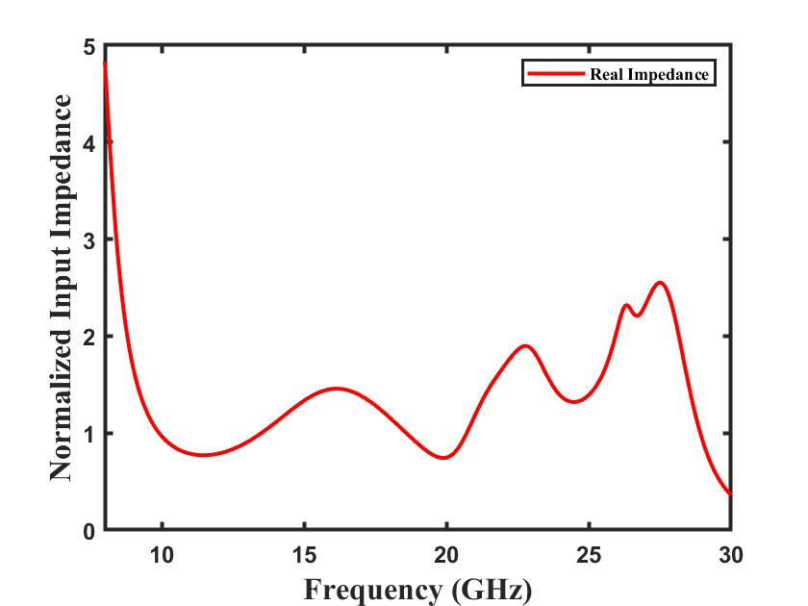
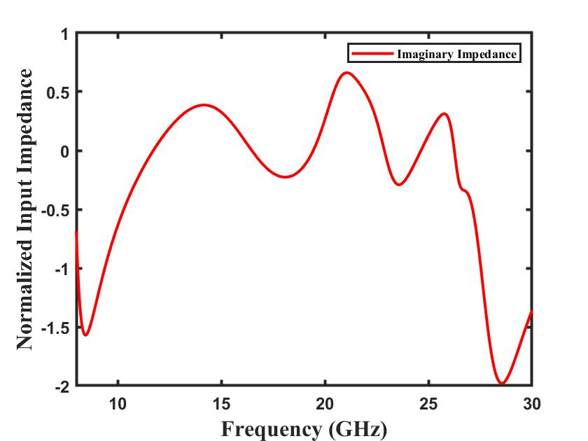
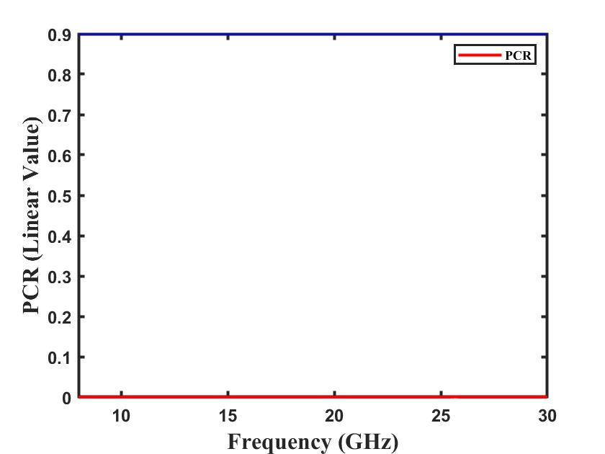
Results
Fig. TE
Fig. TM
Fig. Polarization
Fig. Impedance (Real)
Fig. Impedance (Imaginary)
Fig. PCR value

Slide 6
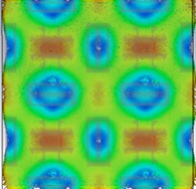
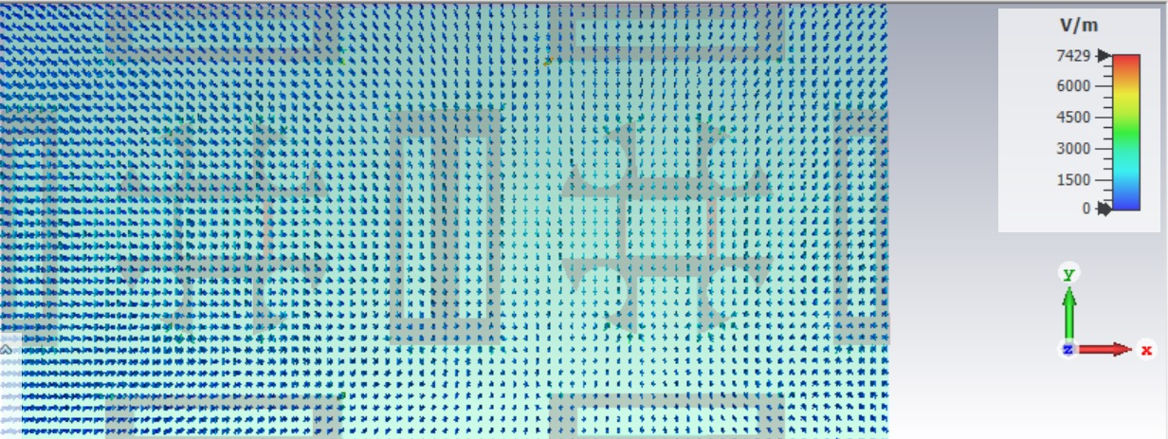
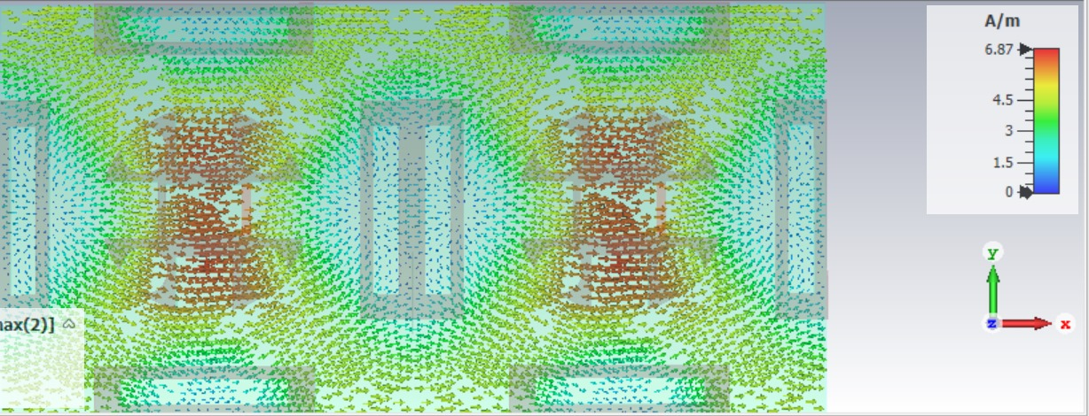
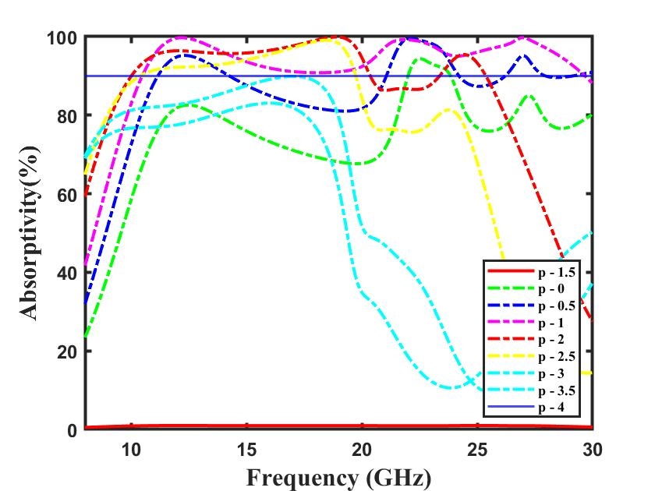
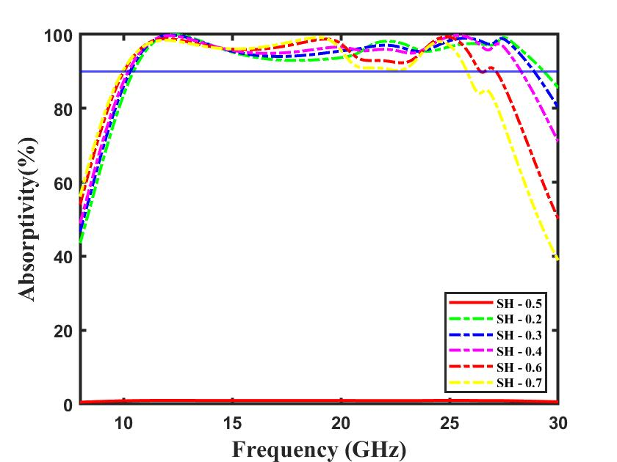
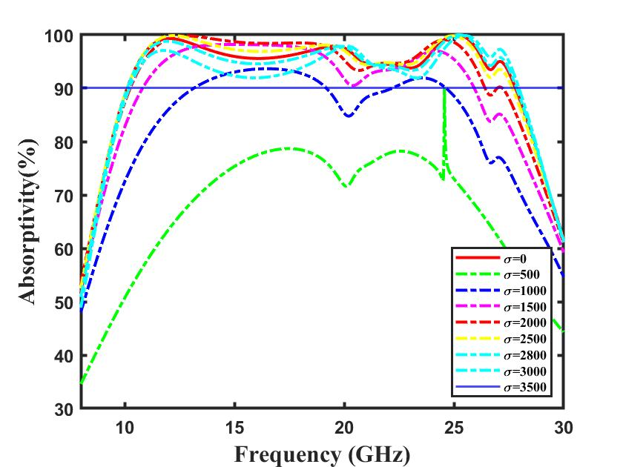
Fig. Surface Current
Fig. E-field
Fig. H-field
Parametric Analysis
Fig. Effect of air gap
Fig. Effect of substrate thickness
Fig. Effect of change in conductivity of ink

Slide 7
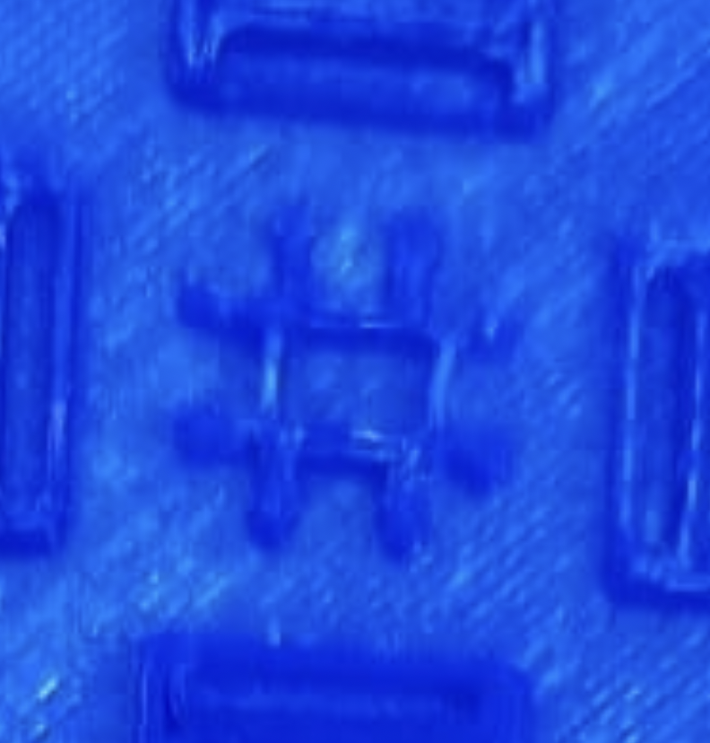

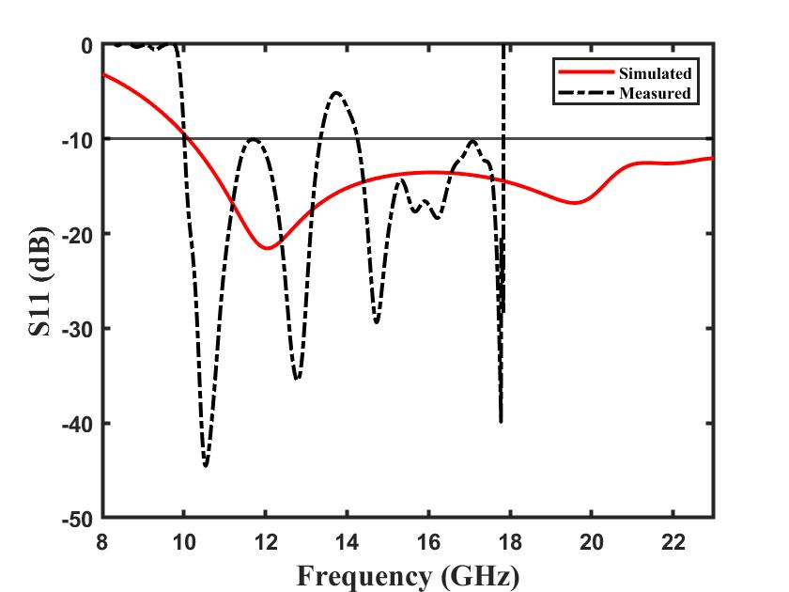
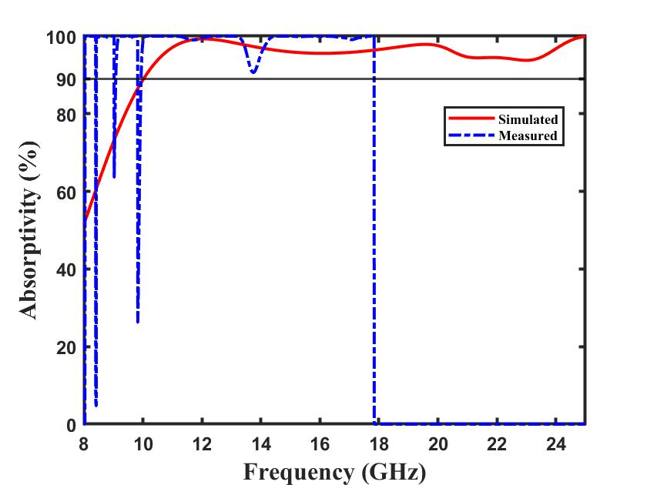
Simulated vs Fabricated Results
Fig. Reflection Coefficient (S11)
Fig.Absorptivity

Slide 8





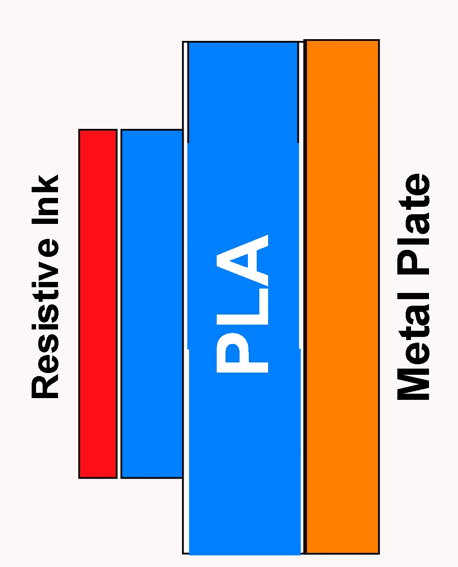
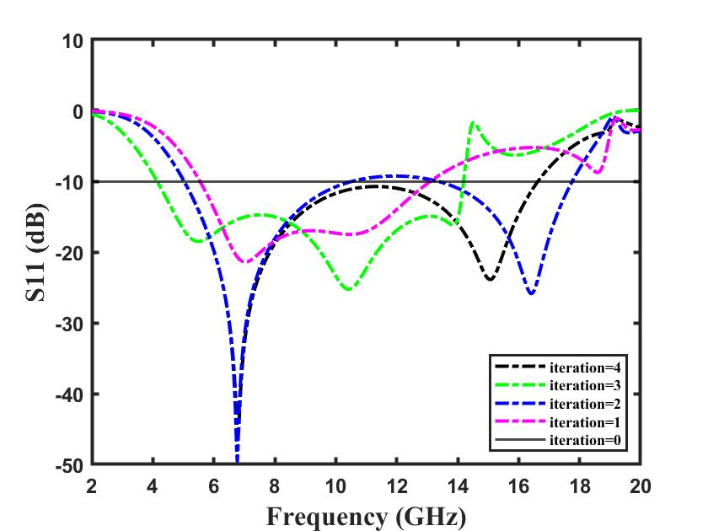
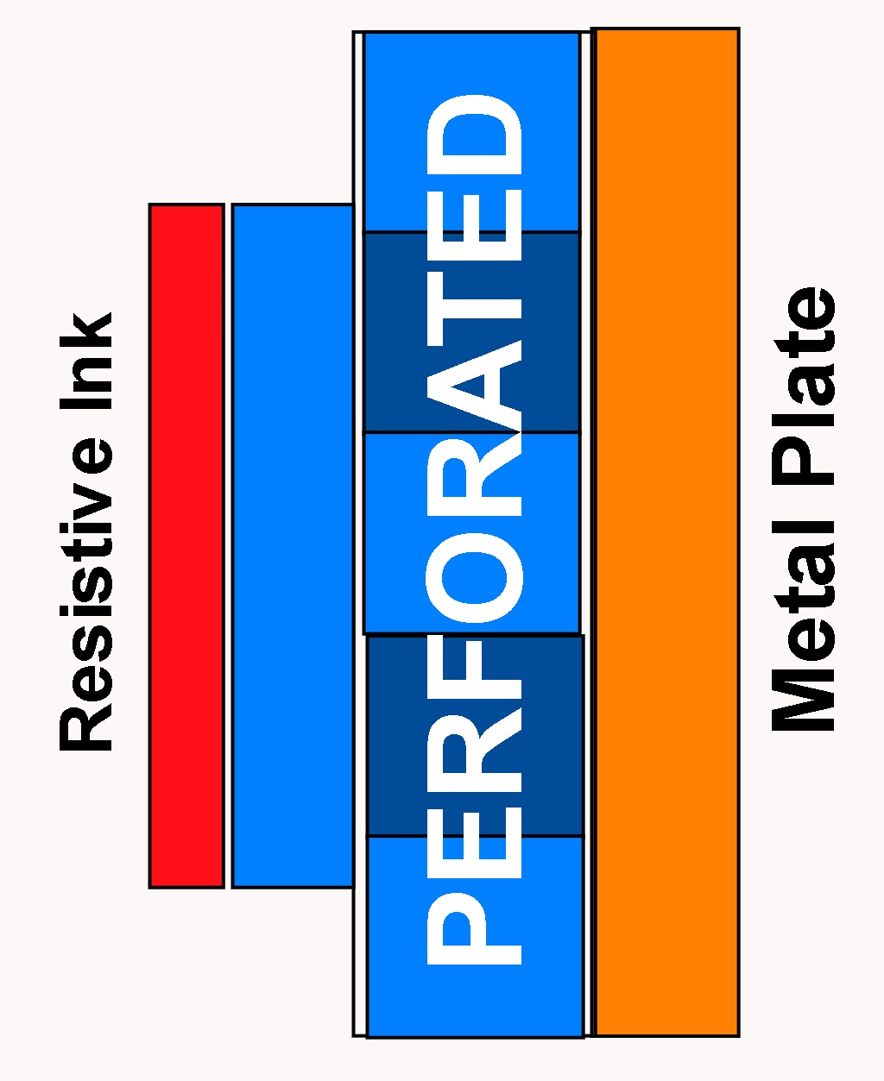
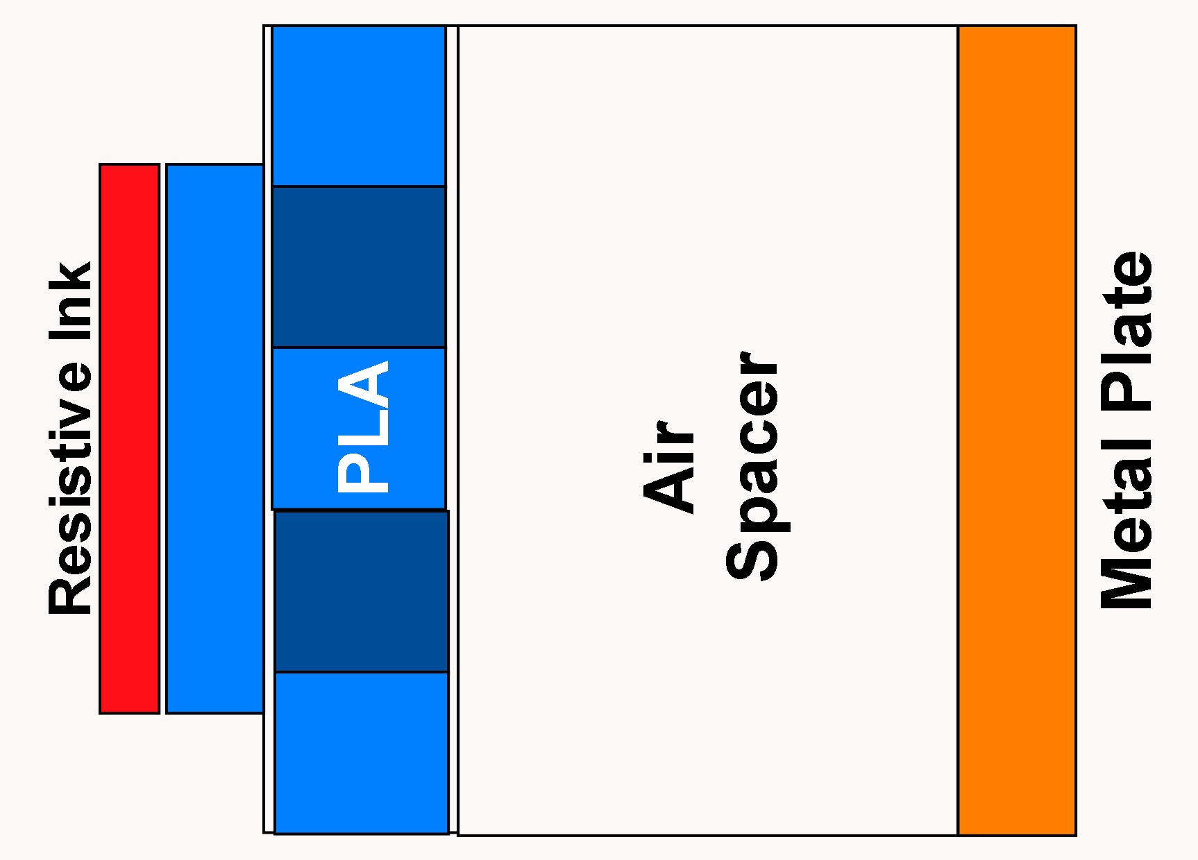
Design 2
iteration 0
(b) iteration 1
(c) iteration 2
(d) iteration 3
(e) iteration 5
iteration 0
iteration 1
iteration 2

Slide 9
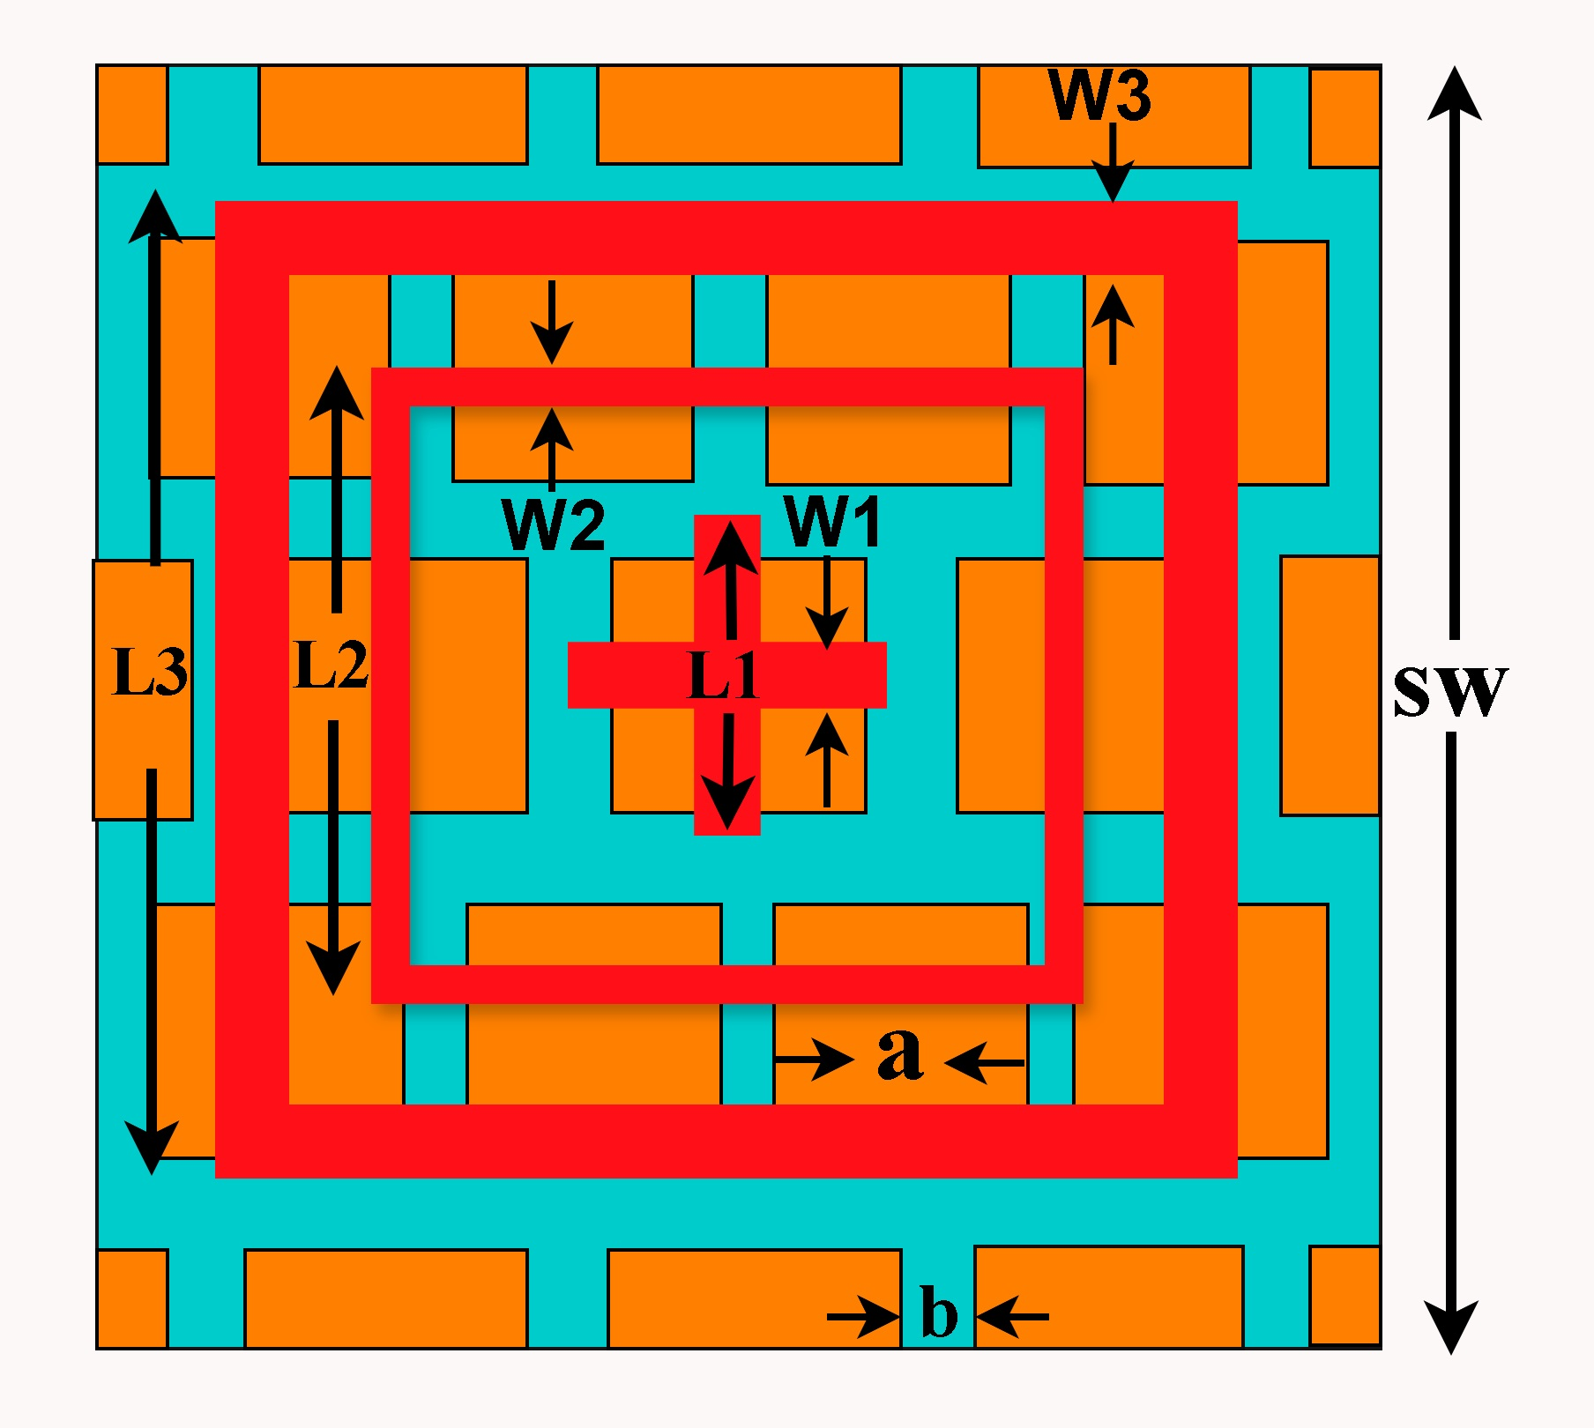
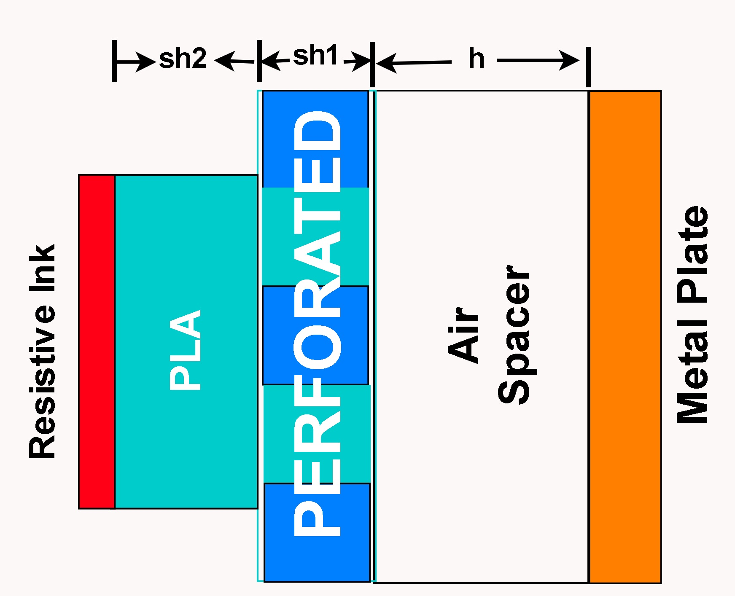
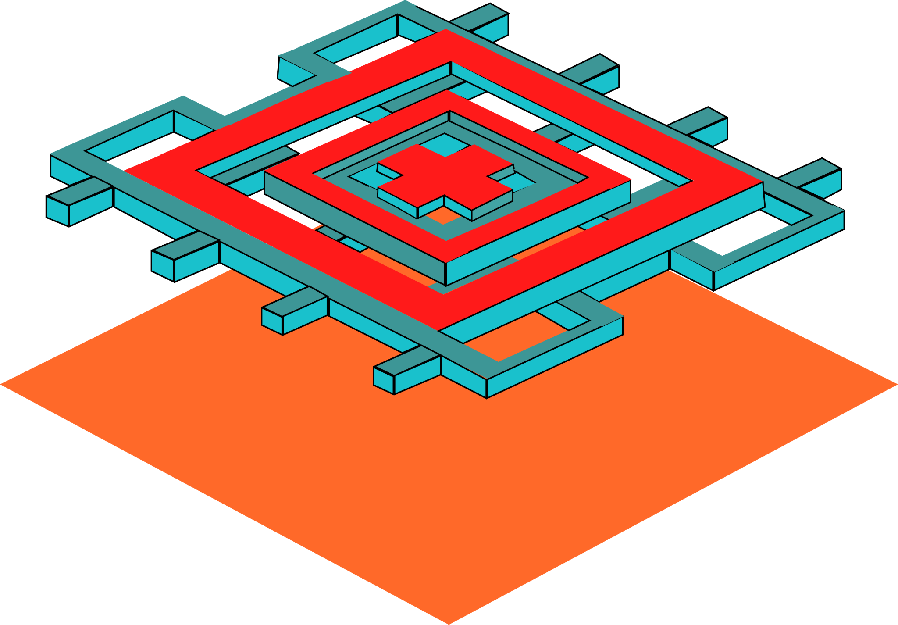
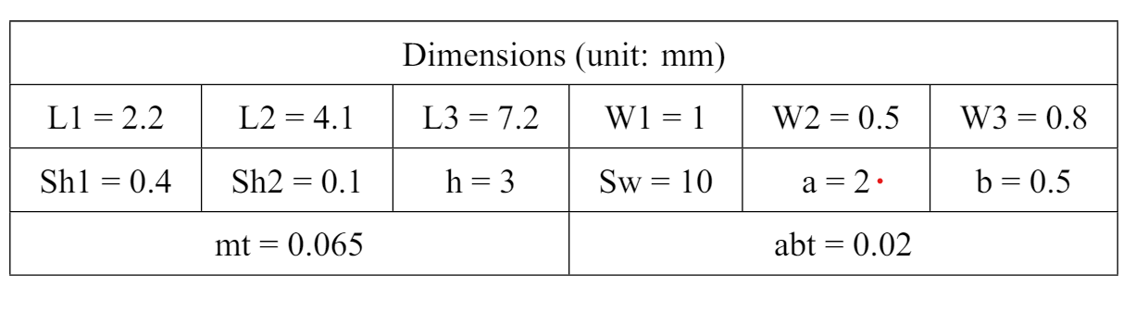
Final Design
Rear View
Front View
Side View

Slide 10
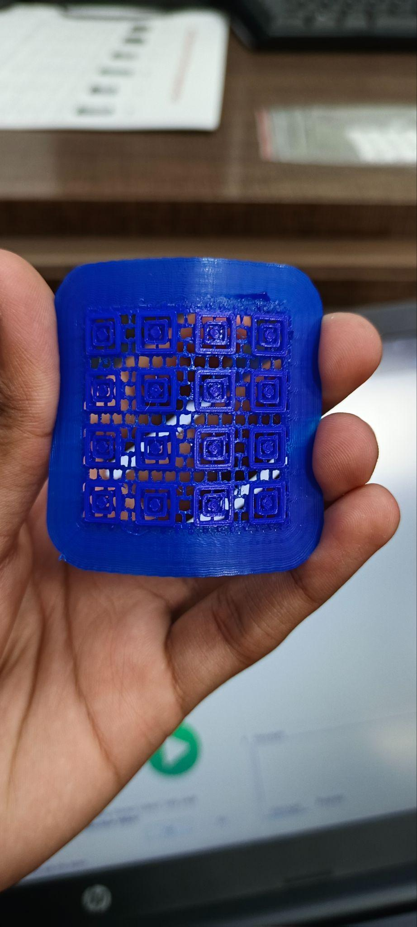
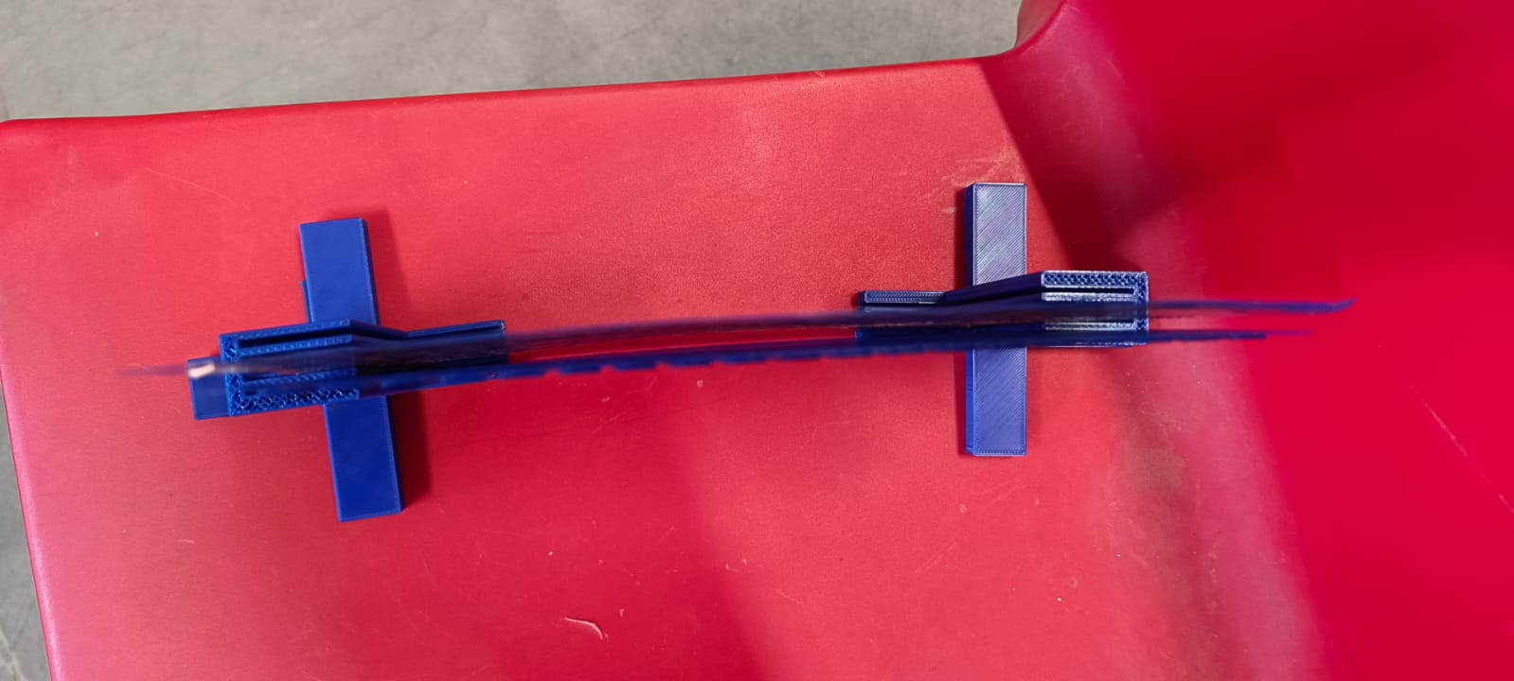
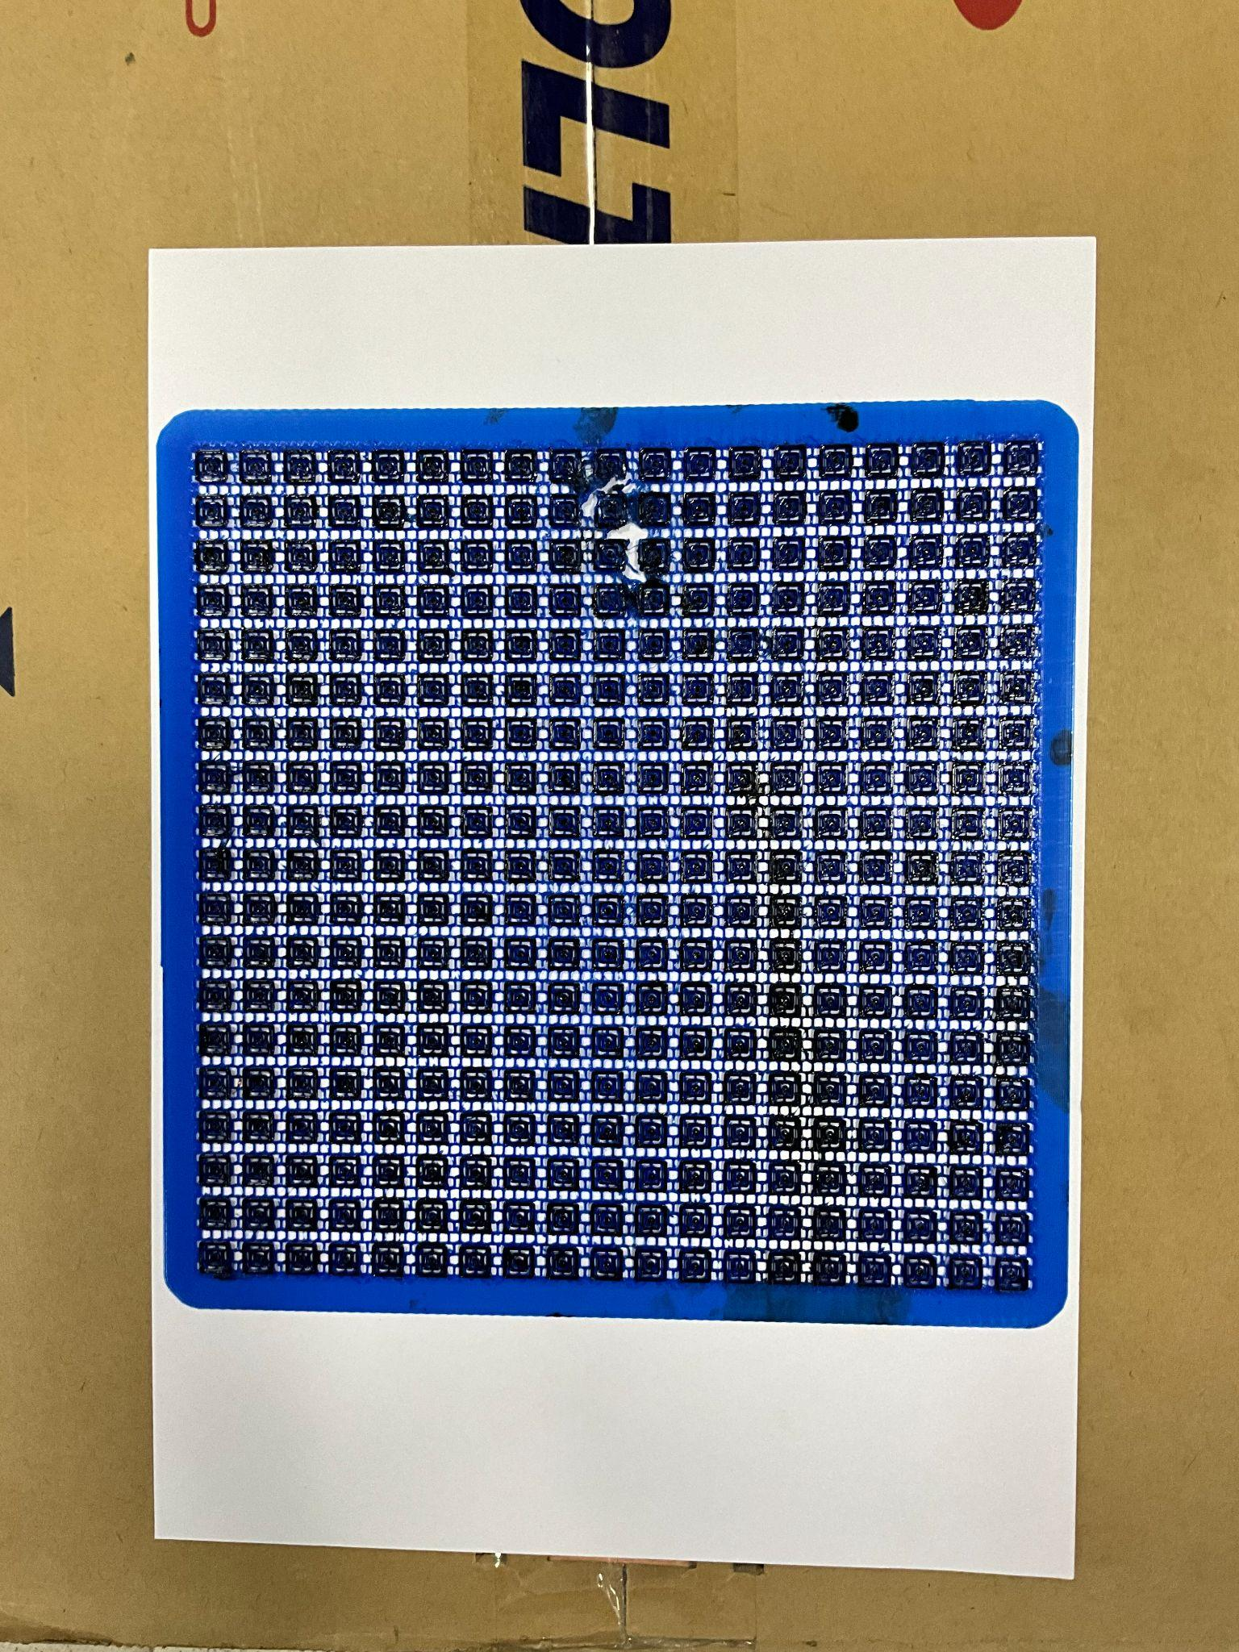
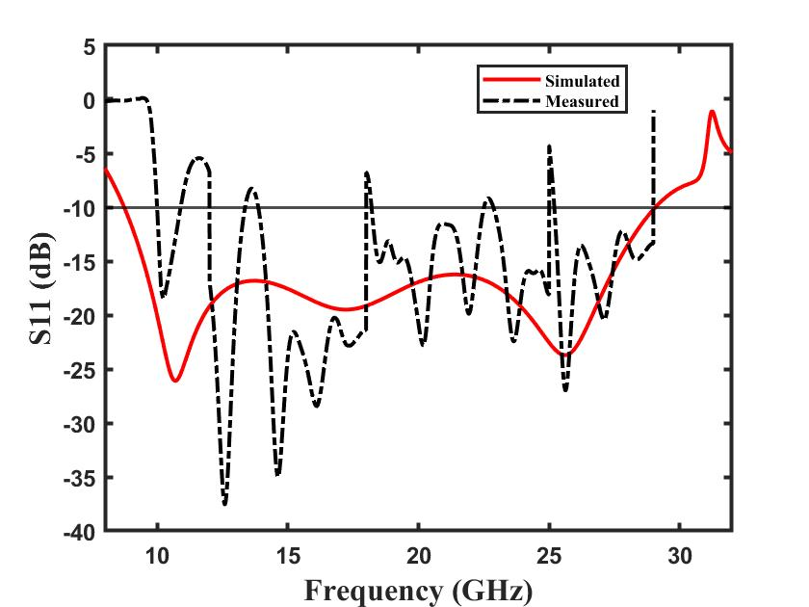
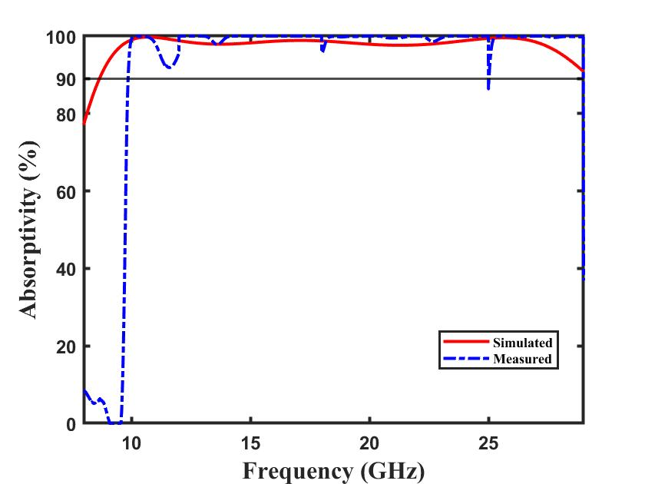
Simulated vs Fabricated Results
Fig. Reflection Coefficient (S11)
Fig.Absorptivity

Slide 11
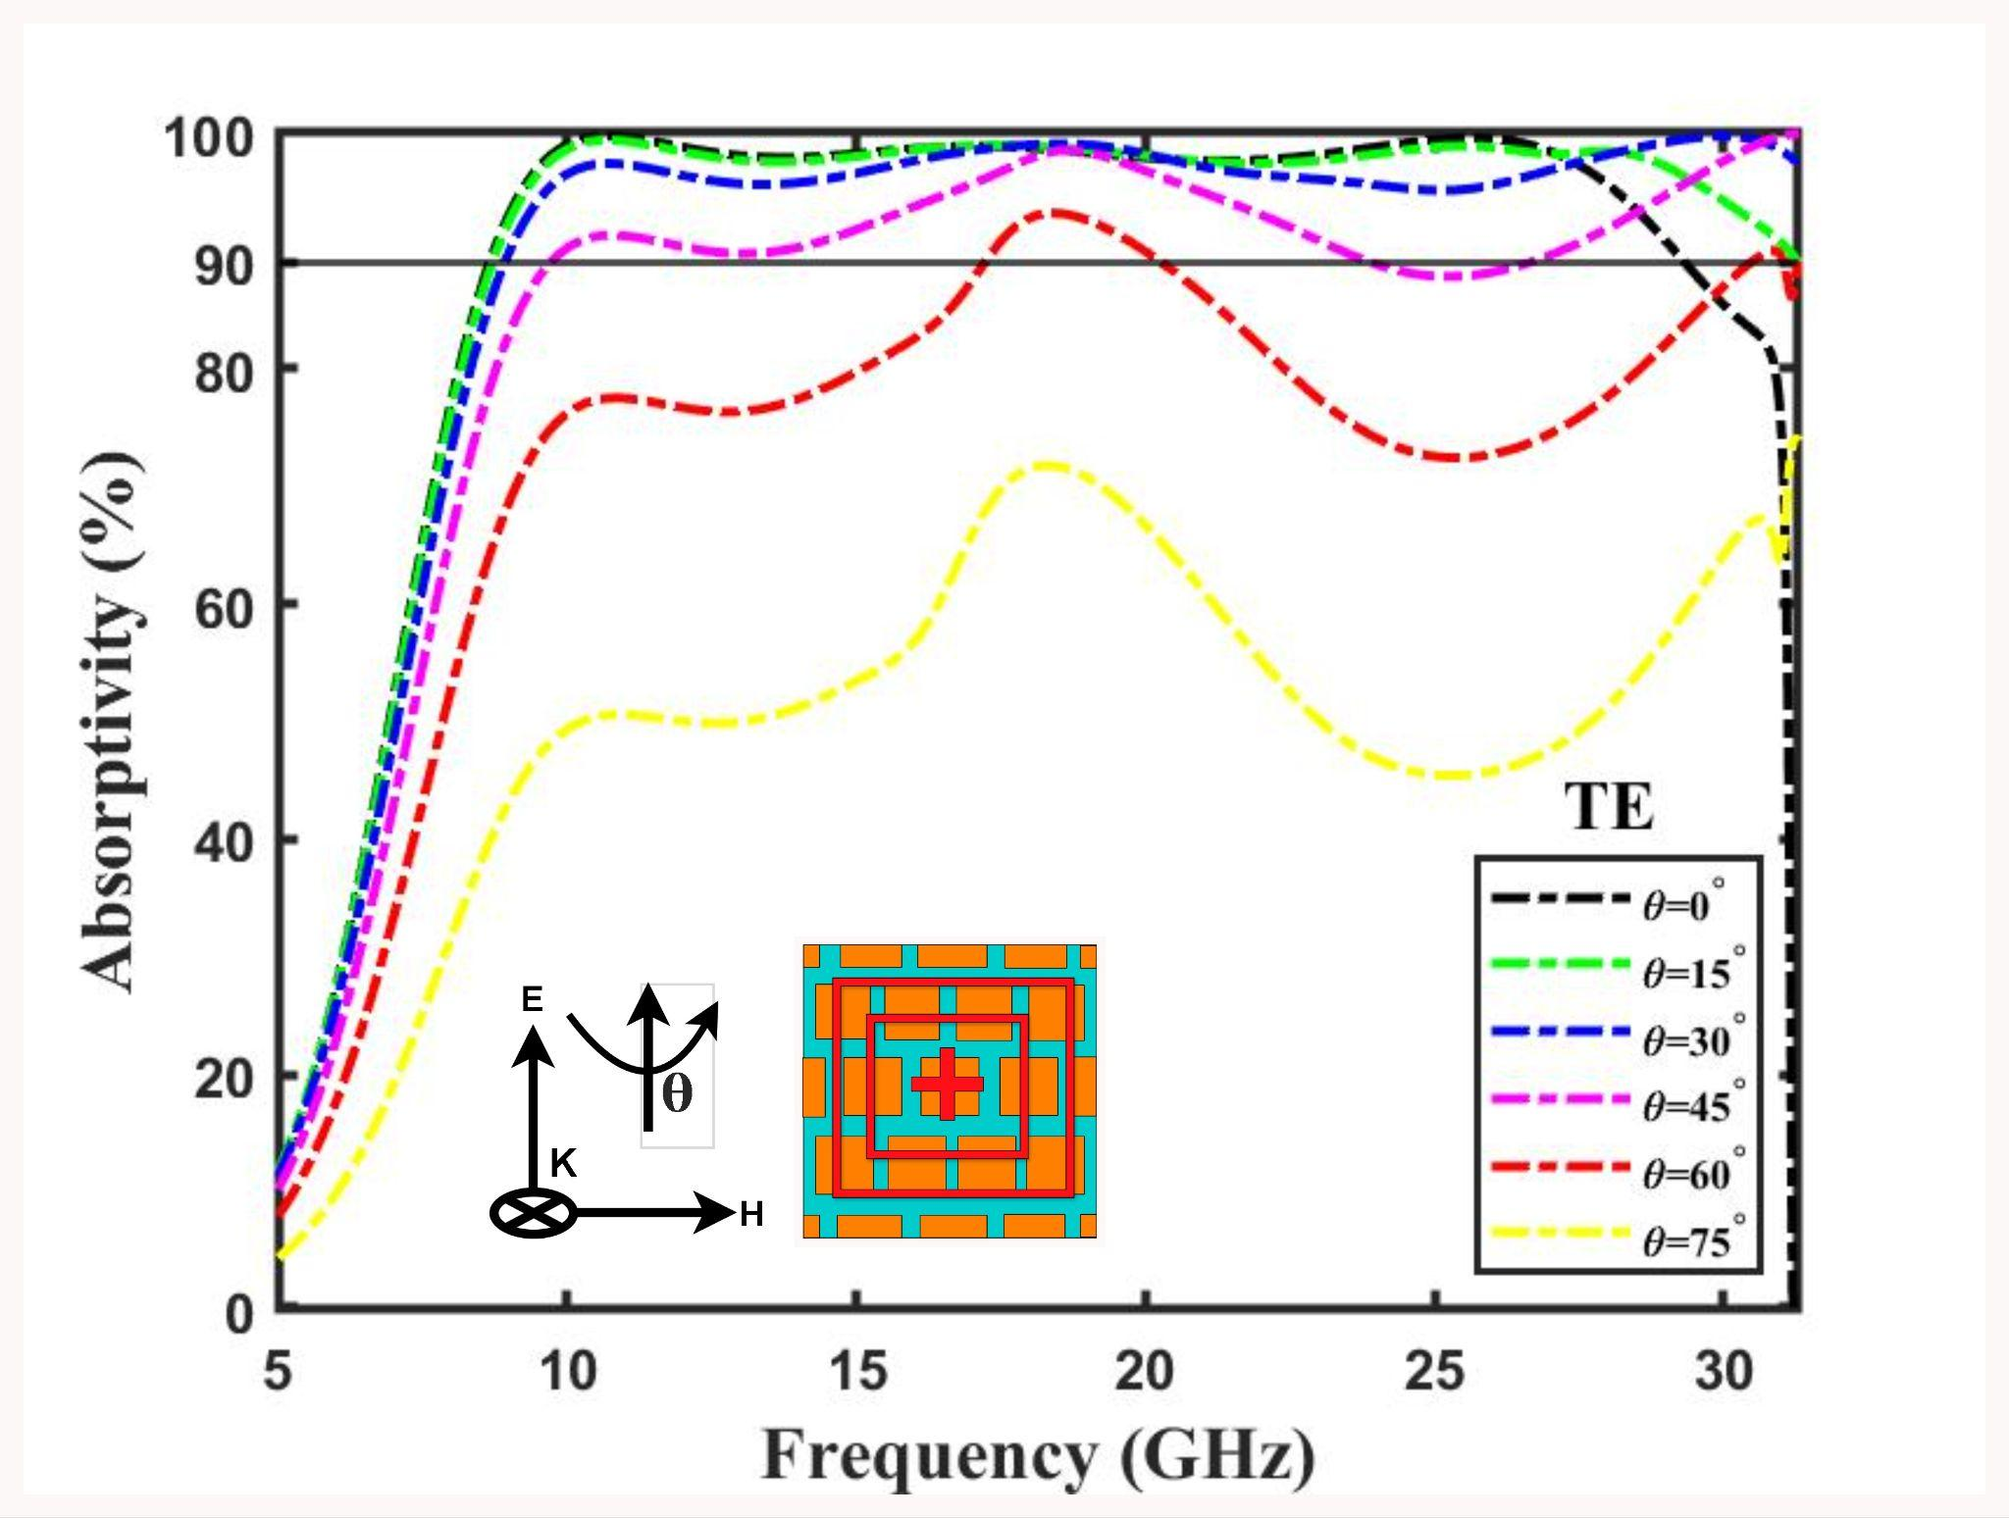
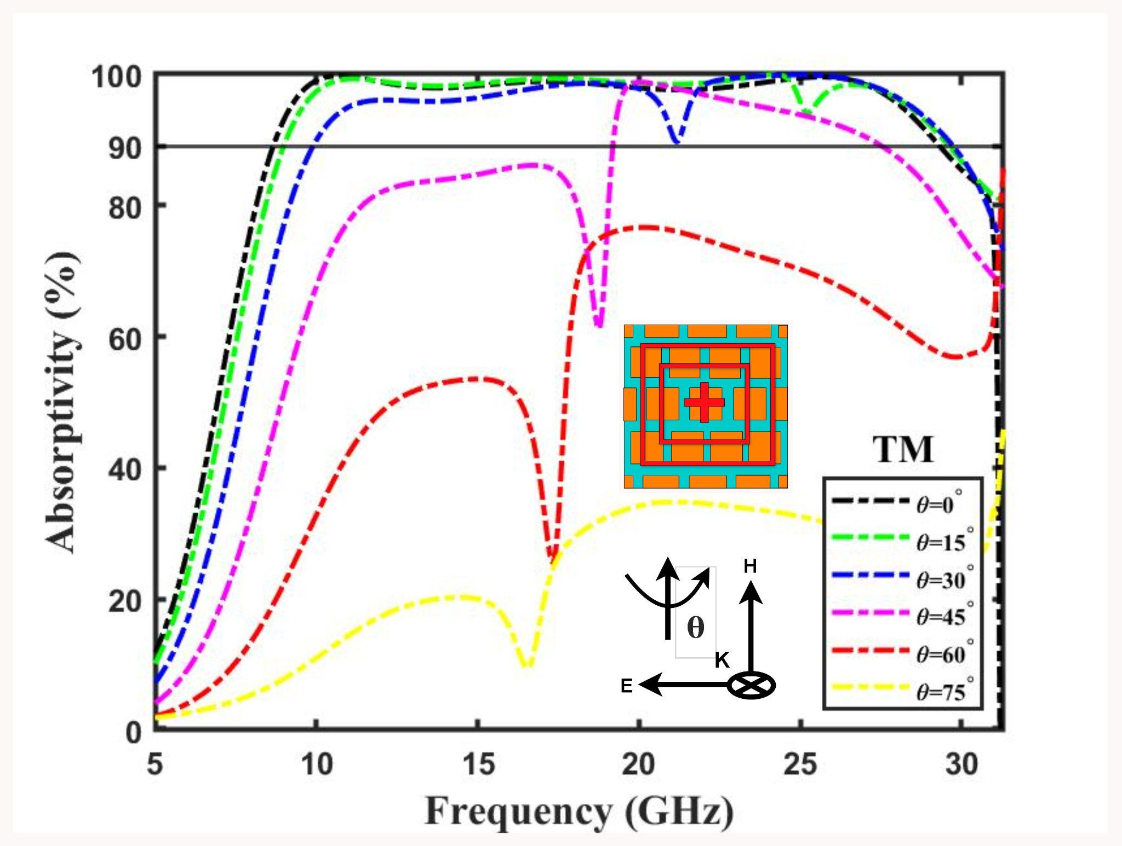
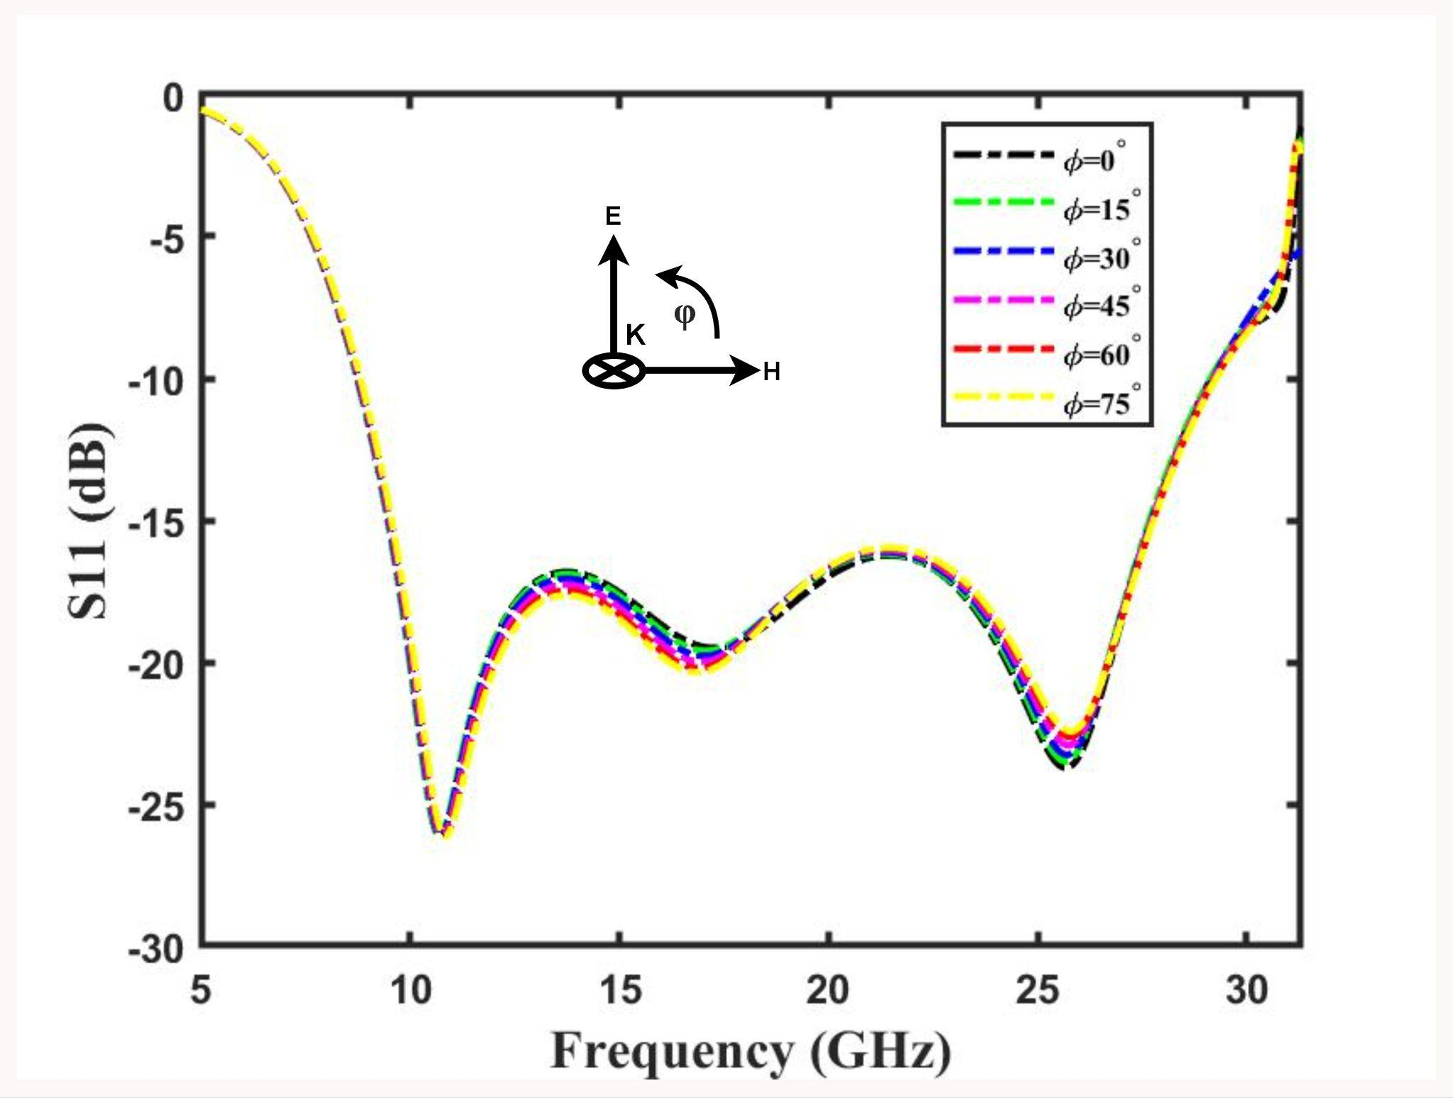
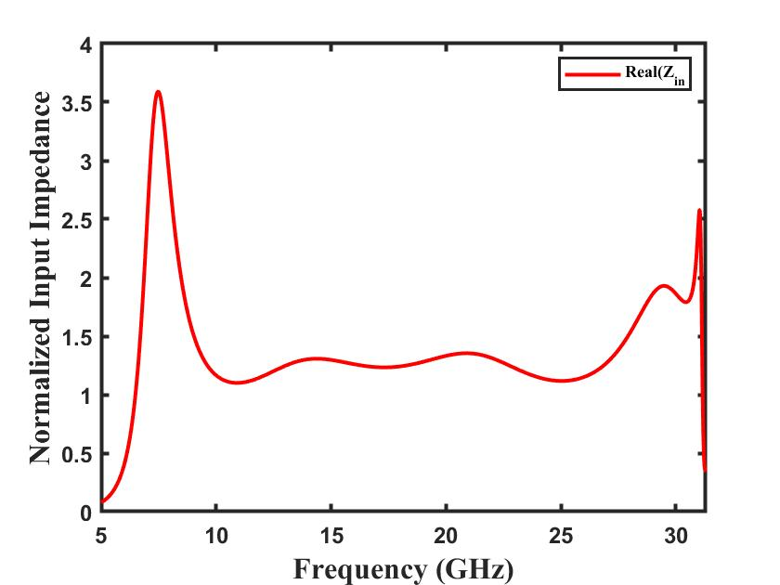
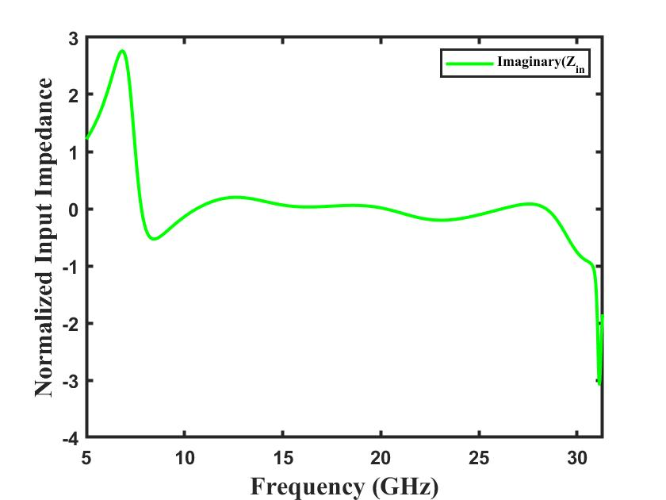
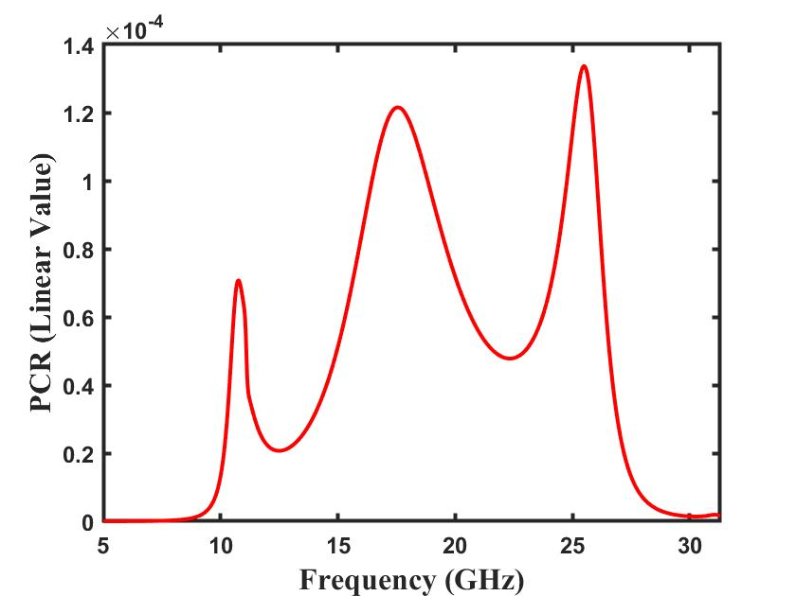
Results
Fig. TE
Fig. TM
Fig. Polarization
Fig. Impedance (Real)
Fig. Impedance (Imaginary)
Fig. PCR value

Slide 12
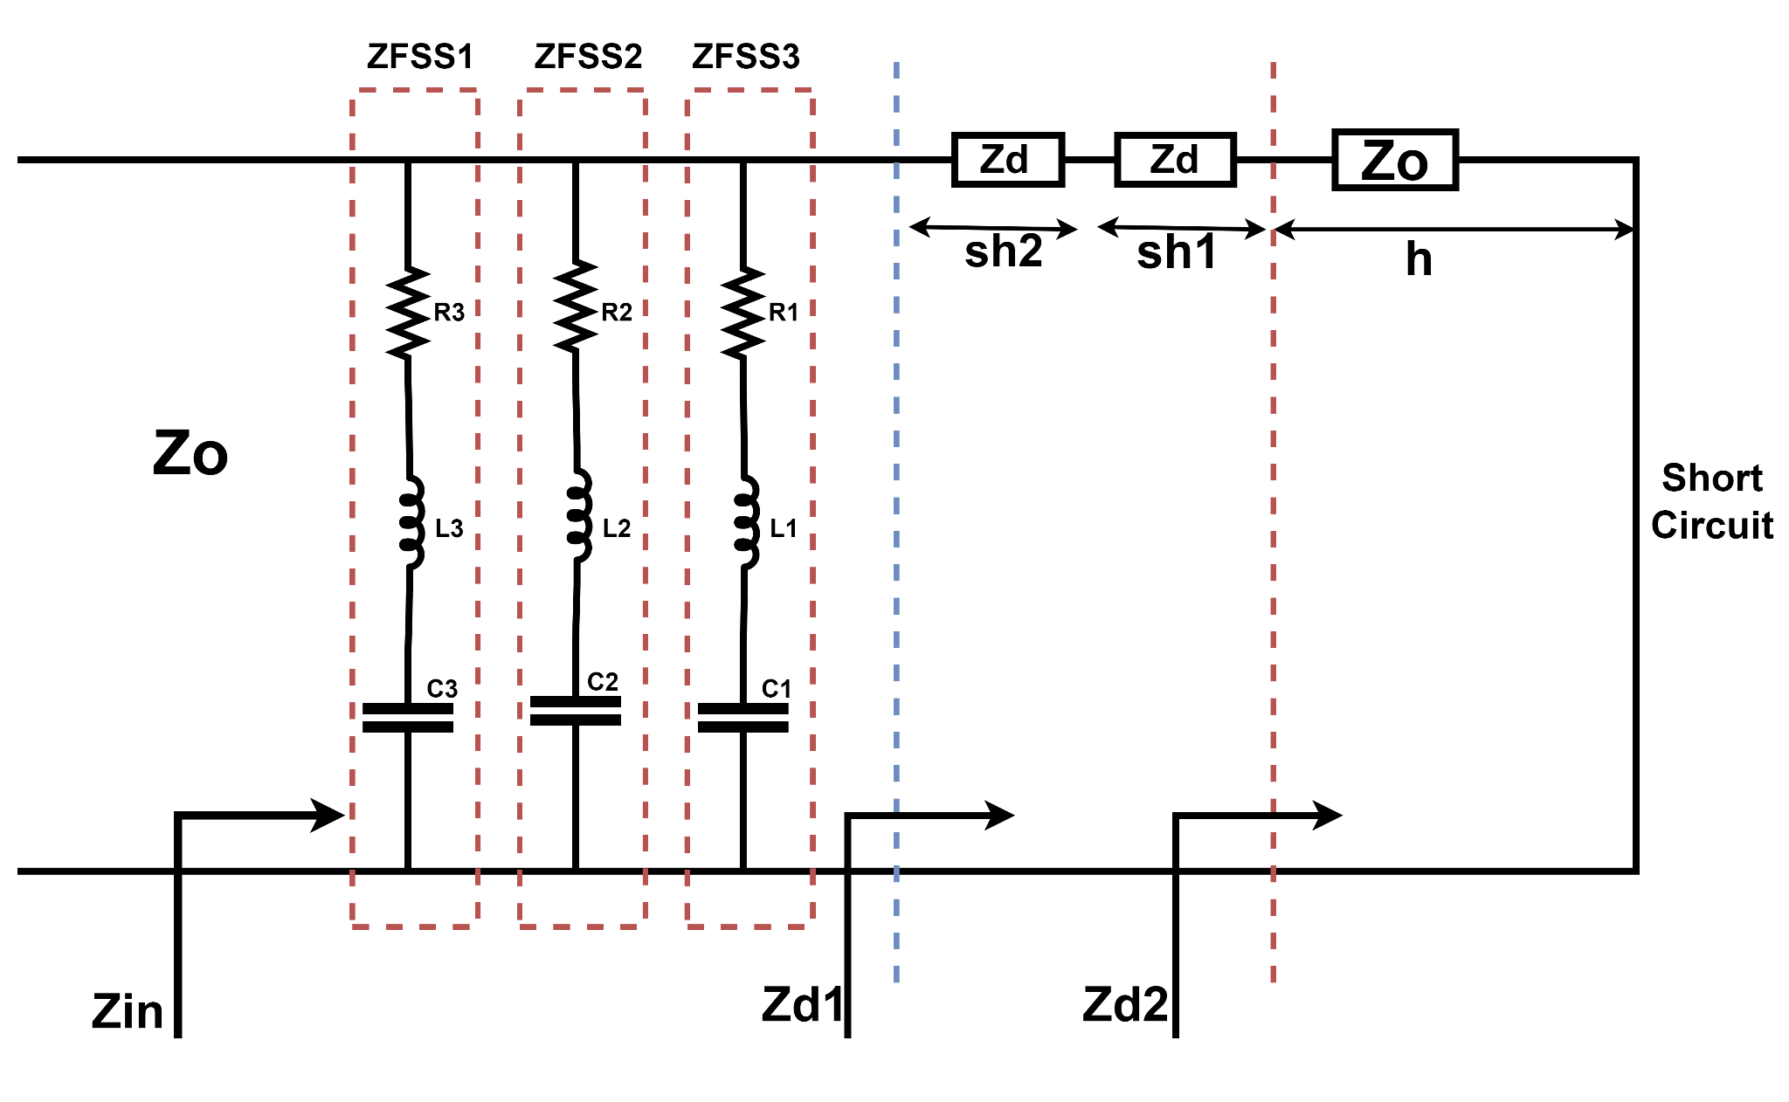
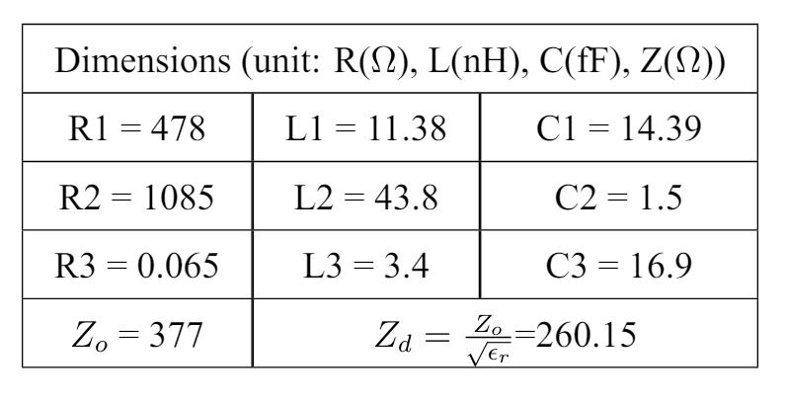
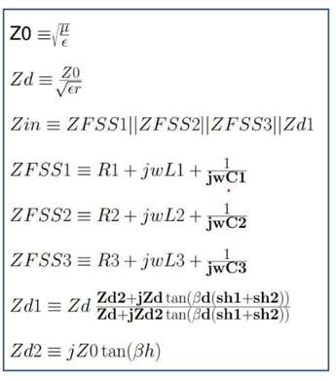
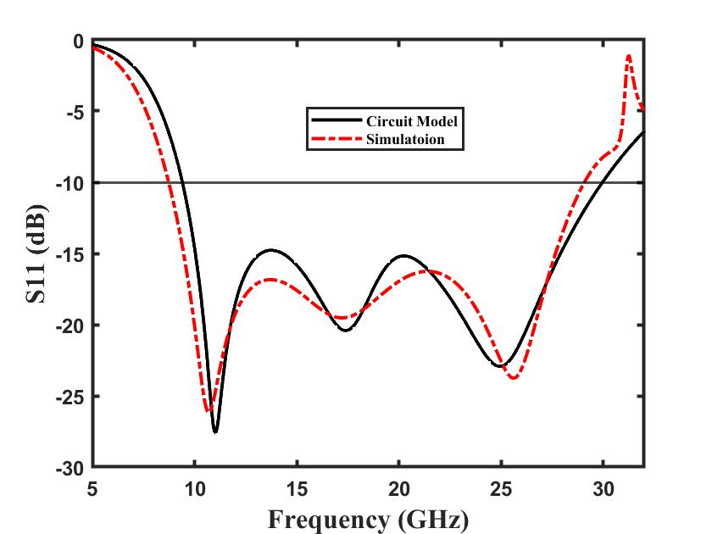
Equivalent Circuit
Fig.Equivalent Circuit
Fig. Reflection Coefficient (S11)

Slide 13
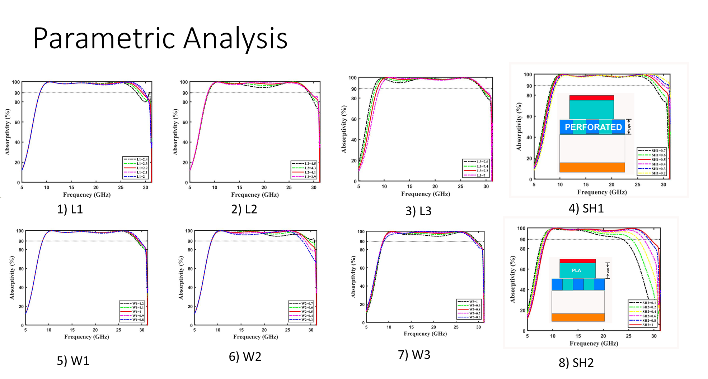

Slide 14
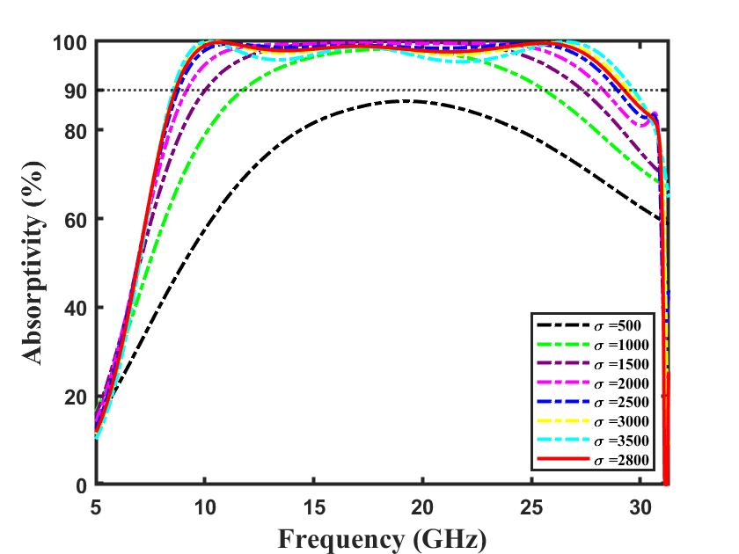
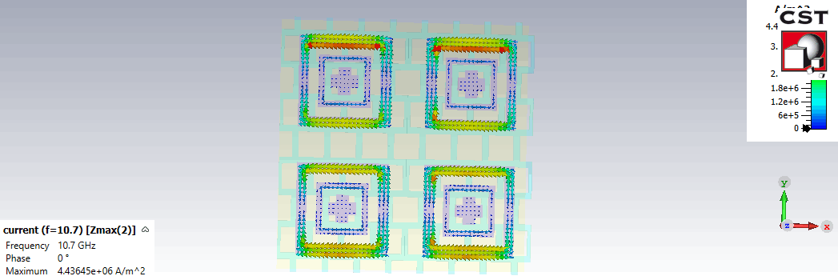
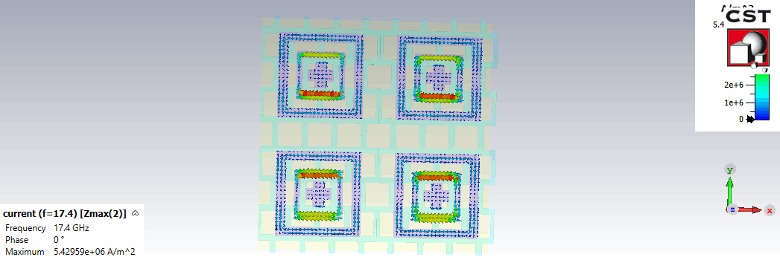





Surface Current density
TE:
10.7 GHz
(b) 17.4 GHz
(c) 25.7 GHz
Fig. Effect of change in conductivity of ink
TM:
10.7 GHz
(b) 17.4 GHz
(c) 25.7 GHz
Fig. Effect of Air Spacer

Slide 15






Bending Analysis
Front View
Side View
Rear View
Fig.Absorptivity

Slide 16



Fabrication and Measurement

Slide 17



Testing

Slide 18
Comparison Table
 | Unit Cell Size (in mm) | Dielectric Thickness (in mm) | Center Frequency (in GHz) | Air Space (in mm) | Resistors | Conformal | BW (in GHz) | Angular stability (>90)
[1] | 16 | 5.5 | 11.24 | 0 | NO | NO | 11.44 | 45 for TE
[2] | 10 | 0.3 | 9.1 | 7 | YES | NO | 5.7 | 30 for TE
[3] | 13 | 1.6 | 11.59 | 3 | YES | NO | 13.5 | 30 for TE
[4] | 14.4 | 0.18 | 9.56 | 3.5 ® | YES | YES | 7.04 | 30 for TE
[5] | 15.8 | 0.125 | 12.93 | 2.5 ® | NO | YES | 12.14 | NA
[6] | 12.5 | 0.07 | 7.2 | 7.5 | Yes | YES | 6.6 | 45 for TE
Proposed Design-1 | 16 | 2 | 12 | 1.5 | NO | NO | 17.69 | 45 for TE
Proposed Design-2 | 10 | 1.5 | 18.9 | 2 | NO | YES | 20.34 | 45 for TE

Slide 19
Conclusion
Developed broadband, highly flexible metamaterial based absorbers.
Two absorber designs have been proposed suitable for wideband & polarisation insensitive at X band and K band respectively.
Proposed Absorber | Frequency Range (in GHz)
Design-1 | 10.1-27.8
Design-2 | 8.73-29.07
Materials Used
Ground Plane | Copper | Conductivity = 5.8x10^7
Substrate | PLA | Ɛr=2.1, Loss Tangent=0.07
Absorber (Resistive INK) | Y-Shield | Conductivity = 2800 S/m

Slide 20
References
Khan, Zainab & Ejaz, Tahir & Zaidi, Tahir & Imtiaz, Hina. (2020). DESIGN OF FSS BASED MICROWAVE ABSORBER FOR WIDEBAND ABSORPTION APPLICATIONS.
Toan Trung Nguyen, Sungjoon Lim; Angle- and polarization-insensitive broadband metamaterial absorber using resistive fan-shaped resonators. Appl. Phys. Lett. 8 January 2018; 112 (2): 021605
S. K. Srivastava, B. Satyanarayana, A. K. Saurabh and M. K. Meshram, "Polarization-Insensitive Ultra wideband Absorber Based on Resistive Rising Sun-Shaped Metasurface," 2019 IEEE Asia-Pacific Microwave Conference (APMC), Singapore, 2019, pp. 548-550, doi: 10.1109/APMC46564.2019.9038357.
Thi Quynh Hoa Nguyen, Thi Kim Thu Nguyen, Thanh Nghia Cao, Hugo Nguyen, Long Giang Bach; Numerical study of a broadband metamaterial absorber using a single split circle ring and lumped resistors for X-band applications. AIP Advances 1 March 2020; 10 (3): 035326.
S. Guo, Y. -L. Zhang, Y. He, L. Miao and J. -J. Jiang, "Design of a Broadband and Switchable Absorber Using an Absorb/Reflective FSS," 2019 Photonics & Electromagnetics Research Symposium - Fall (PIERS - Fall), Xiamen, China, 2019, pp. 2144-2148, doi: 10.1109/PIERS-Fall48861.2019.9021344.
Ling Liu, Wenwen Liu, Zhengyong Song; Ultra-broadband terahertz absorber based on a multilayer graphene metamaterial. J. Appl. Phys. 7 September 2020; 128 (9): 093104.
https://doi.org/10.1016/j.optcom.2015.03.072
Shuo Liu, Haibing Chen, Tie Jun Cui; A broadband terahertz absorber using multi-layer stacked bars. Appl. Phys. Lett. 13 April 2015; 106 (15): 151601.
B. X. Wang, X. Zhai, G. Z. Wang, W. Q. Huang and L. L. Wang, "Design of a Four-Band and Polarization-Insensitive Terahertz Metamaterial Absorber," in IEEE Photonics Journal, vol. 7, no. 1, pp. 1-8, Feb. 2015, Art no. 4600108, doi: 10.1109/JPHOT.2014.2381633.
S. Ghosh, S. Bhattacharyya, D. Chaurasiya and K. V. Srivastava, "An Ultra Wideband Ultrathin Metamaterial Absorber Based on Circular Split Rings," in IEEE Antennas and Wireless Propagation Letters, vol. 14, pp. 1172-1175, 2015, doi: 10.1109/LAWP.2015.2396302.
H. Zhai, C. Zhan, Z. Li and C. Liang, "A Triple-Band Ultrathin Metamaterial Absorber With Wide-Angle and Polarization Stability," in IEEE Antennas and Wireless Propagation Letters, vol. 14, pp. 241-244, 2015, doi: 10.1109/LAWP.2014.2361011.
W. Ma, Y. Wen and X. Yu, "Theoretical and Experimental Demonstrations of a Dual-Band Metamaterial Absorber at Mid-Infrared," in IEEE Photonics Technology Letters, vol. 26, no. 19, pp. 1940-1943, 1 Oct.1, 2014, doi: 10.1109/LPT.2014.2342275.
B. -X. Wang, L. -L. Wang, G. -Z. Wang, W. -Q. Huang, X. -F. Li and X. Zhai, "Metamaterial-Based Low-Conductivity Alloy Perfect Absorber," in Journal of Lightwave Technology, vol. 32, no. 12, pp. 2293-2298, 15 June15, 2014, doi: 10.1109/JLT.2014.2322860.
P. Min, Z. Song, L. Yang, V. G. Ralchenko, and J. Zhu, “Optically Transparent Flexible Broadband Metamaterial Absorber Based on Topology Optimization Design,” Micromachines, vol. 12, no. 11, p. 1419, Nov. 2021
Avinash, Nisha Gupta. An Ultrathin Graphite Based Absorber for Wearable Applications, 03 June 2021, PREPRINT (Version 1) available at Research Square [https://doi.org/10.21203/rs.3.rs-480007/v1]

Slide 21

Thank You !

